Slide 1
Curse of dimensionality and Linear Algebra
1
BDATA 412: Advanced Data Visualization
University of Washington

Slide 2
Motivation

Slide 3
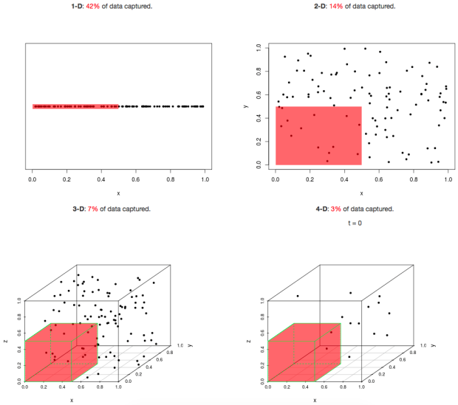
What Is the Curse of Dimensionality?
Why more features can mean less information

Slide 4
Distance Concentration
In high dimensions, "near" and "far" lose their meaning
VISUAL INTUITION
PRACTICAL INTUITION
Low dimensions: distances vary
What breaks
Distance-based methods (k-NN, k-means, clustering) lose discriminating power — the contrast between nearest and furthest neighbor diminishes.
What to do
Reduce dimensions first (PCA, LDA, UMAP)
Use cosine similarity instead of Euclidean
Switch to tree-based models (Random Forest, XGBoost)
pairwise distance →
High dimensions: distances collapse
nearly all distances
are the same
pairwise distance →
Rule of thumb: if your nearest neighbor and your farthest neighbor are within 10% of each other, distance is no longer a useful signal.

Slide 5
Sparsity
The volume of high-dimensional space empties out faster than you can fill it
VISUAL INTUITION
PRACTICAL INTUITION
1D
The exponential problem
Data needed to cover the sample space grows exponentially with dimensions — usually impractical to collect.
What to do
Feature selection: keep only the most relevant features (preserves interpretability)
Feature extraction: project to a lower-D space via PCA / LDA (better performance, less interpretable)
10 pts
2D
10 pts
3D
10 pts
Intuition flip: you don't have "too few data points" — you have "too much empty space."

Slide 6
Nearest-Neighbor Breakdown
When everyone is equally far, "nearest" is just noise
VISUAL INTUITION
PRACTICAL INTUITION
Low dimensions
High dimensions
What breaks
k-NN, k-means and clustering rely on a meaningful gap between nearest and furthest neighbor. In high-D that gap vanishes.
What to do
Reduce dimensions before applying distance methods
Pick metrics designed for high-D (cosine, Mahalanobis)
Use tree-based or kernel models that don't need raw distances
clear nearest neighbors
all points ≈ equidistant
If your kNN classifier suddenly stops working when you add features, the geometry is fighting you — not your code.

Slide 7
Overfitting Risk
With enough features, a model can memorize anything — including noise
VISUAL INTUITION
PRACTICAL INTUITION
Why it happens
More features = more model complexity. The model starts learning noise instead of signal, so it nails training data but fails on new data.
What to do
Regularization: Lasso (L₁) and Ridge (L₂) penalize large coefficients
Robust models: Random Forests handle high-D well via built-in feature selection
Preprocess: normalize and standardize so no single feature dominates
Good fit
Overfit
Data
x (feature)
The wiggly pink curve fits every training point — including the noise — and will fail on new data.
If training accuracy is 99% and test accuracy is 60%, the curse isn't in your model — it's in your feature count.

Slide 8
Curse of
Dimensionality

Slide 9


Slide 10
What Is the Curse of Dimensionality?
Why more features can mean less information
DEFINITION & INTUITION
WHEN TO WORRY
Distance concentration
As dimensions grow, all pairwise distances converge — max ≈ min.
Sparsity
Data points become isolated; need exponentially more data to fill the space.
Nearest-neighbor breakdown
When all points are equidistant, 'nearest' is meaningless.
Overfitting risk
Many features + few samples = model finds spurious patterns.
p > n datasets
Genomics, NLP bag-of-words, survey data with hundreds of questions.
Adding noise features
Irrelevant variables drown out the signal in useful features.
Computational burden
Distance calculations scale as O(np), storage as O(np).
Mitigation
Feature selection, PCA, regularization, manifold methods.
The Party Analogy: 20 people in a small room feel crowded. The same 20 in a 100D hyper-warehouse are all equally far apart.

Slide 11
K-Nearest Neighbors (KNN) Algorithm
Pseudocode — Classification by Majority Vote of K Nearest Neighbors
KNN_Classify(training_set, query_point, K):
1. For each point xᵢ in training_set:
distance[i] ← dist(xᵢ, query_point)
2. Sort distances in ascending order
3. Select the K nearest neighbors
neighbors ← top K points from sorted list
4. Count class votes among neighbors:
For each neighbor in neighbors:
votes[neighbor.class] += 1
5. Return class with maximum votes
Key Concepts
Distance Metric
Euclidean, Manhattan, or Minkowski distance between feature vectors
Choice of K
Odd K avoids ties; small K = noise-sensitive; large K = smooth boundaries
Majority Vote
The query point is classified to the most frequent class among its K neighbors
No Training Phase
KNN is a lazy learner — all computation happens at prediction time

Slide 12
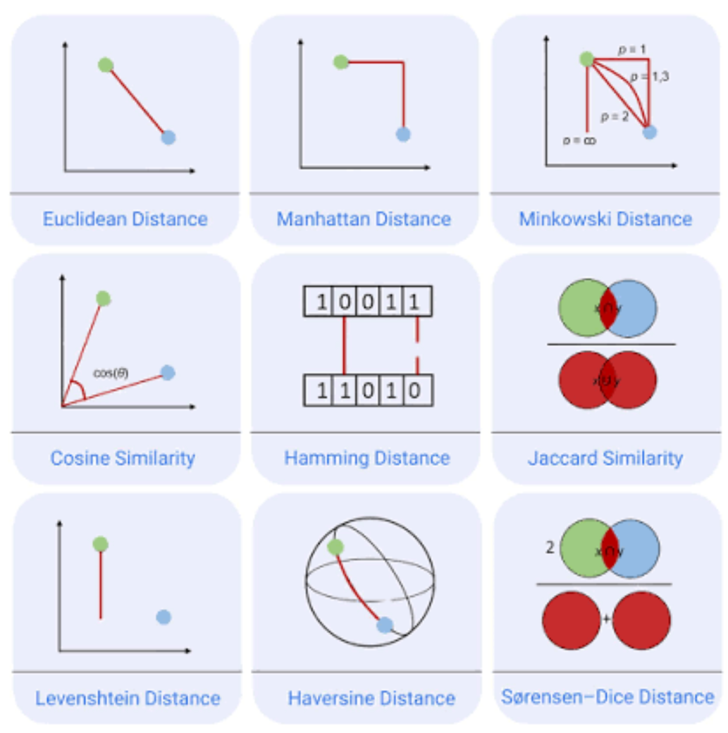

Slide 13
KNN Visual Example: K=5 with Two Classes
The 5 nearest neighbors vote: 3 Class A (purple) vs 2 Class B (gold) → Query classified as Class A
How It Works
1. Compute Distances
Measure distance from query (teal) to every training point
2. Find 5 Nearest
Select K=5 closest points inside the dashed boundary
3. Majority Vote
Class A (purple): 3 votes
Class B (gold): 2 votes
4. Classification
Query → Class A
(majority wins)
K = 5
Feature X₂
?
Feature X₁
Class A
Class B
Query Point

Slide 14
Curse of dimensionality — Stage 1: d = 1 (one feature)
Training set (5 points, labels)
Query
Distance: |x* − xᵢ| k = 3 nearest neighbors
x₁=1 (A) x₂=2 (A) x₃=4 (B) x₄=7 (B) x₅=9 (B)
x* = 5
d(x*, xᵢ) = | 5 − xᵢ |
0
1
2
3
4
5
6
7
8
9
10
A
A
B
x* = 5
B
B
Geometry — points on the number line, query in purple
Step 1 — compute distances and sort
Step 2 — majority vote of 3 nearest
d(5, 1) = |5 − 1| =
4
3 nearest: x₃ (B, d=1), x₄ (B, d=2), x₂ (A, d=3)
d(5, 2) = |5 − 2| =
3
nearest
Votes: B = 2, A = 1
d(5, 4) = |5 − 4| =
1
nearest
Predicted label → B
d(5, 7) = |5 − 7| =
2
nearest
d(5, 9) = |5 − 9| =
4
Distance concentration diagnostic
min distance = 1 max distance = 4
max / min = 4 / 1 = 4.0× → neighbors are clearly different from far points
In 1D, the nearest neighbor is 4× closer than the farthest point — KNN has plenty of signal to vote on.

Slide 15
Stage 2 — d=2 (two features)
Training set
Query
Distance formula
x₁=(1,2)·A x₂=(2,1)·A x₃=(4,8)·B x₄=(7,5)·B x₅=(9,9)·B
x* = (5, 5)
d(x,y) = √((x₁−y₁)² + (x₂−y₂)²)
x₂
x₂
10
10
x₅
Points spread out in a plane. The 3 nearest to x*=(5,5):
• x₄=(7,5) class B — distance 2.00
• x₃=(4,8) class B — distance 3.16
• x₁=(1,2) class A — distance 5.00
Majority vote → B (2 of 3). Signal still strong.
x₃
Class A
Class B
x₂
x₄
Query x*=(5,5)
5
x*
5
3 nearest neighbors
0
0
x₁
0
x₁
0
5
5
10
x₁
10
Step 1 — compute distance from x* to every point
Step 2 — 3-NN majority vote
d(x*, x₁) = √((5−1)² + (5−2)²) = √(16+9) = √25
5.00
tied 3rd
1st: x₄=(7,5)·B at 2.00 2nd: x₃=(4,8)·B at 3.16
d(x*, x₂) = √((5−2)² + (5−1)²) = √(9+16) = √25
5.00
tied 3rd
3rd: x₁=(1,2)·A at 5.00 (tied with x₂; break by index)
d(x*, x₃) = √((5−4)² + (5−8)²) = √(1+9) = √10
3.16
2nd
Vote → B (2 of 3)
d(x*, x₄) = √((5−7)² + (5−5)²) = √(4+0) = √4
2.00
1st
d(x*, x₅) = √((5−9)² + (5−9)²) = √(16+16) = √32
5.66
Distance diagnostic — ratio of farthest to nearest neighbor
max distance = 5.66 min distance = 2.00
ratio = 5.66 / 2.00 = 2.83× (still useful — nearest is clearly closer than farthest)
In d=2, distances still discriminate well: the nearest neighbor is 2.83× closer than the farthest. KNN's similarity signal is intact.

Slide 16
KNN in 2D — query x*=(5,5) with 3 nearest neighbors
x₂
10
Class A
x₅
Class B
x₃
Query x*
3-NN highlight
7.5
d = 3.16
d = 2.0
x₄
5
x* = (5, 5)
d = 5.00
2.5
x₁
x₂
0
0
2.5
5
7.5
10
x₁

Slide 17
Stage 3 — d=10 (ten features)
Training set (10-dim vectors)
x₁ = (1, 2, 0, 8, 8, 5, 5, 5, 5, 5) (A)
x₂ = (2, 1, 0, 9, 7, 5, 5, 5, 5, 5) (A)
x₃ = (4, 8, 0, 0, 3, 4, 5, 5, 5, 5) (B)
x₄ = (7, 5, 0, 0, 8, 8, 5, 5, 5, 5) (B)
x₅ = (9, 9, 0, 8, 6, 5, 5, 5, 5, 5) (B)
Query
x* = (5,5,5,5,5,5,5,5,5,5)
Distance formula
d(x,y) = √(Σⱼ₌₁¹⁰ (xⱼ−yⱼ)²)

Slide 18
Stage 3 — d=10 (ten features)
Step 1 · Distance from query x* to x₁ (class A)
coord j | 1 | 2 | 3 | 4 | 5 | 6 | 7 | 8 | 9 | 10 | Σ
x*ⱼ | 5 | 5 | 5 | 5 | 5 | 5 | 5 | 5 | 5 | 5
x₁ⱼ | 1 | 2 | 0 | 8 | 8 | 5 | 5 | 5 | 5 | 5
x₁ⱼ − 5 | −4 | −3 | −5 | 3 | 3 | 0 | 0 | 0 | 0 | 0
(x₁ⱼ − 5)² | 16 | 9 | 25 | 9 | 9 | 0 | 0 | 0 | 0 | 0 | 68
d(x*, x₁) = √(16+9+25+9+9) = √68 ≈ 8.25
Rank 3 of 5
Only 5 of 10 coordinates differ from the query — the other 5 contribute 0; yet the total still lands near √68, close to every other point.

Slide 19
Stage 3 — d=10 (ten features)
Step 1 — Euclidean distances to all 5 training points
Step 2 — 3-NN majority vote
d(x*, x₁) = √(Σ (x₁ⱼ − 5)²) = √68
8.25
3rd
1st: x₃·B at 8.06 2nd: x₅·B at 8.19
d(x*, x₂) = √(Σ (x₂ⱼ − 5)²) = √70
8.37
3rd: x₁·A at 8.25 (just 0.12 from 4th)
d(x*, x₃) = √(Σ (x₃ⱼ − 5)²) = √65
8.06
1st
Vote → B (2 of 3) — but the margin is tiny
d(x*, x₄) = √(Σ (x₄ⱼ − 5)²) = √72
8.49
d(x*, x₅) = √(Σ (x₅ⱼ − 5)²) = √67
8.19
2nd

Slide 20
Stage 3 — d=10 (ten features)
Distance now collapses — all 5 neighbors land in a tiny pink band, so 'nearest' barely beats 'farthest'
Zoomed view (8.0 – 8.5)
Full scale (0–10)
d₃
8.06
d₅
8.19
d₁
8.25
d₂
8.37
d₄
8.49
0
5
10
8.0
8.5
← all 5 neighbors fit in this pink dot
Total spread: only 0.43 distance units (≈5%) — the signal is gone
Distance diagnostic — ratio of farthest to nearest neighbor
max distance = 8.49 min distance = 8.06
ratio = 8.49 / 8.06 = 1.05× (everything looks equidistant — the signal is gone)
In d=10, all five neighbors sit within about 5% of each other. The 'nearest neighbor' is nearly arbitrary — KNN's core assumption breaks.

Slide 21
Exercise 1 — Find the 1-NN in 2D (k = 1)
Training set — 2D points (x, y) with class
Your task
Point x y Class
A 2 3 ● Red
B 5 4 ● Red
C 9 6 ▲ Blue
D 4 7 ▲ Blue
E 8 1 ● Red
1. Compute the Euclidean distance from q*
to each of the five training points.
2. Identify the single nearest neighbour
(smallest distance).
3. Assign q* that neighbour's class.
Distance: d = √( (xᵢ−x*)² + (yᵢ−y*)² )
Query point
Hint
q* = (6, 5)
Which class does 1-NN assign?
You can compare squared distances — no need
to take square roots to find the minimum.
Solution
🔒 Solution hidden — work it out first, then remove this cover to reveal.
d(q*,A)=√(16+4)=√20≈4.47 d(q*,B)=√(1+1)=√2≈1.41 d(q*,C)=√(9+1)=√10≈3.16
d(q*,D)=√(4+4)=√8≈2.83 d(q*,E)=√(4+16)=√20≈4.47
Nearest neighbour = B at distance ≈ 1.41 → 1-NN assigns q* the class ● Red
With k = 1 the decision is just the closest point — in low dimensions distances are well separated and the nearest neighbour is unambiguous.

Slide 22
Exercise 1 — Solution · Point A (1-NN, k = 1)
Euclidean distance from query q* to Point A
q* = ( 6, 5 )
A = ( 2, 3 ) ● Red
A − q* = ( -4, -2 )
(A−q*)² = ( 16, 4 )
Σ squares = 16 + 4 = 20
d(q*,A) = √20 ≈ 4.47
Rank 4 of 5
4th (tie)
Class
● Red
Ranking by Σ (squared distance) is identical to ranking by d, since √ is monotonic — the hint lets you skip the square root.

Slide 23
Exercise 1 — Solution · Point B (1-NN, k = 1)
Euclidean distance from query q* to Point B
q* = ( 6, 5 )
B = ( 5, 4 ) ● Red
B − q* = ( -1, -1 )
(B−q*)² = ( 1, 1 )
Σ squares = 1 + 1 = 2
d(q*,B) = √2 ≈ 1.41
Rank 1 of 5
1st — nearest
Class
● Red
Ranking by Σ (squared distance) is identical to ranking by d, since √ is monotonic — the hint lets you skip the square root.

Slide 24
Exercise 1 — Solution · Point C (1-NN, k = 1)
Euclidean distance from query q* to Point C
q* = ( 6, 5 )
C = ( 9, 6 ) ▲ Blue
C − q* = ( 3, 1 )
(C−q*)² = ( 9, 1 )
Σ squares = 9 + 1 = 10
d(q*,C) = √10 ≈ 3.16
Rank 3 of 5
3rd
Class
▲ Blue
Ranking by Σ (squared distance) is identical to ranking by d, since √ is monotonic — the hint lets you skip the square root.

Slide 25
Exercise 1 — Solution · Point D (1-NN, k = 1)
Euclidean distance from query q* to Point D
q* = ( 6, 5 )
D = ( 4, 7 ) ▲ Blue
D − q* = ( -2, 2 )
(D−q*)² = ( 4, 4 )
Σ squares = 4 + 4 = 8
d(q*,D) = √8 ≈ 2.83
Rank 2 of 5
2nd
Class
▲ Blue
Ranking by Σ (squared distance) is identical to ranking by d, since √ is monotonic — the hint lets you skip the square root.

Slide 26
Exercise 1 — Solution · Point E (1-NN, k = 1)
Euclidean distance from query q* to Point E
q* = ( 6, 5 )
E = ( 8, 1 ) ● Red
E − q* = ( 2, -4 )
(E−q*)² = ( 4, 16 )
Σ squares = 4 + 16 = 20
d(q*,E) = √20 ≈ 4.47
Rank 4 of 5
4th (tie)
Class
● Red
Ranking by Σ (squared distance) is identical to ranking by d, since √ is monotonic — the hint lets you skip the square root.

Slide 27
Exercise 1 — Solution · Answer (1-NN, k = 1)
Rank the five distances and take the single nearest neighbour
1st B √2 ≈ 1.41 ● Red ← nearest
2nd D √8 ≈ 2.83 ▲ Blue
3rd C √10 ≈ 3.16 ▲ Blue
4th A √20 ≈ 4.47 ● Red
4th E √20 ≈ 4.47 ● Red
ANSWER
1-NN →
● Red
With k = 1 the decision is just the closest point (B). In 2D distances are well separated, so the nearest neighbour is unambiguous.

Slide 28
Exercise 2 — Find the 3-NN in 3D (k = 3)
Training set — 3D points (x, y, z) with class
Your task
Pt x y z Class
P1 1 2 1 ● Red
P2 3 3 2 ● Red
P3 6 5 5 ▲ Blue
P4 2 4 3 ● Red
P5 7 6 4 ▲ Blue
P6 5 2 6 ▲ Blue
1. Compute the Euclidean distance from q*
to each of the six training points.
2. Select the three nearest neighbours.
3. Take the majority class among those 3.
Distance:
d = √( (xᵢ−x*)²+(yᵢ−y*)²+(zᵢ−z*)² )
Query point
Hint
q* = (3, 4, 2)
Which class wins the 3-NN majority vote?
Compare squared distances to rank neighbours;
with k = 3, ties are broken by the closest point.
Solution
🔒 Solution hidden — work it out first, then remove this cover to reveal.
d²: P1=9 P2=1 P3=19 P4=2 P5=24 P6=24 → d: P2=1.00 P4≈1.41 P1=3.00 P3≈4.36 P5≈4.90 P6≈4.90
3 nearest = P2 (●Red), P4 (●Red), P1 (●Red)
Majority vote = 3 of 3 Red → 3-NN assigns q* the class ● Red
With k = 3 the vote smooths out single odd neighbours — but adding the z-dimension spreads points further apart, so distances must be recomputed in full 3D.

Slide 29
Exercise 2 — Solution · P1 (3-NN, k = 3)
Euclidean distance from query q* to P1 in 3D
q* = ( 3, 4, 2 )
P1 = ( 1, 2, 1 ) ● Red
P1 − q* = ( -2, -2, -1 )
(P1−q*)² = ( 4, 4, 1 )
Σ squares = 4 + 4 + 1 = 9
d(q*,P1) = √9 = 3.00
Rank 3 of 6
3rd — in 3-NN
Class
● Red
Adding the z-dimension changes every distance — all three coordinates contribute to Σ before the square root.

Slide 30
Exercise 2 — Solution · P2 (3-NN, k = 3)
Euclidean distance from query q* to P2 in 3D
q* = ( 3, 4, 2 )
P2 = ( 3, 3, 2 ) ● Red
P2 − q* = ( 0, -1, 0 )
(P2−q*)² = ( 0, 1, 0 )
Σ squares = 0 + 1 + 0 = 1
d(q*,P2) = √1 = 1.00
Rank 1 of 6
1st — nearest
Class
● Red
Adding the z-dimension changes every distance — all three coordinates contribute to Σ before the square root.

Slide 31
Exercise 2 — Solution · P3 (3-NN, k = 3)
Euclidean distance from query q* to P3 in 3D
q* = ( 3, 4, 2 )
P3 = ( 6, 5, 5 ) ▲ Blue
P3 − q* = ( 3, 1, 3 )
(P3−q*)² = ( 9, 1, 9 )
Σ squares = 9 + 1 + 9 = 19
d(q*,P3) = √19 ≈ 4.36
Rank 4 of 6
4th
Class
▲ Blue
Adding the z-dimension changes every distance — all three coordinates contribute to Σ before the square root.

Slide 32
Exercise 2 — Solution · P4 (3-NN, k = 3)
Euclidean distance from query q* to P4 in 3D
q* = ( 3, 4, 2 )
P4 = ( 2, 4, 3 ) ● Red
P4 − q* = ( -1, 0, 1 )
(P4−q*)² = ( 1, 0, 1 )
Σ squares = 1 + 0 + 1 = 2
d(q*,P4) = √2 ≈ 1.41
Rank 2 of 6
2nd — in 3-NN
Class
● Red
Adding the z-dimension changes every distance — all three coordinates contribute to Σ before the square root.

Slide 33
Exercise 2 — Solution · P5 (3-NN, k = 3)
Euclidean distance from query q* to P5 in 3D
q* = ( 3, 4, 2 )
P5 = ( 7, 6, 4 ) ▲ Blue
P5 − q* = ( 4, 2, 2 )
(P5−q*)² = ( 16, 4, 4 )
Σ squares = 16 + 4 + 4 = 24
d(q*,P5) = √24 ≈ 4.90
Rank 5 of 6
5th (tie)
Class
▲ Blue
Adding the z-dimension changes every distance — all three coordinates contribute to Σ before the square root.

Slide 34
Exercise 2 — Solution · P6 (3-NN, k = 3)
Euclidean distance from query q* to P6 in 3D
q* = ( 3, 4, 2 )
P6 = ( 5, 2, 6 ) ▲ Blue
P6 − q* = ( 2, -2, 4 )
(P6−q*)² = ( 4, 4, 16 )
Σ squares = 4 + 4 + 16 = 24
d(q*,P6) = √24 ≈ 4.90
Rank 5 of 6
5th (tie)
Class
▲ Blue
Adding the z-dimension changes every distance — all three coordinates contribute to Σ before the square root.

Slide 35
Exercise 2 — Solution · Answer (3-NN, k = 3)
Rank all six distances, then take the majority class of the three nearest
1st P2 √1 = 1.00 ● Red ← in 3-NN
2nd P4 √2 ≈ 1.41 ● Red ← in 3-NN
3rd P1 √9 = 3.00 ● Red ← in 3-NN
4th P3 √19 ≈ 4.36 ▲ Blue
5th P5 √24 ≈ 4.90 ▲ Blue
5th P6 √24 ≈ 4.90 ▲ Blue
ANSWER
3-NN majority vote
3 × ● Red
→ ● Red
3-NN set = { P2, P4, P1 } → Red, Red, Red (3 of 3)
With k = 3 the vote is unanimous here, but in higher dimensions the three nearest distances bunch together — the same collapse shown in the main deck.

Slide 36
Linear Algebra
The language of data

Slide 37
Why represent data as matrices and vectors?
1
2
3
Compact notation
Geometry unlocks meaning
Built for computation
Instead of writing dozens of equations for each feature, one symbol stands for the whole dataset. Less ink, fewer mistakes, easier to reason about.
Vectors live in space. Distances, angles, and projections become natural — similarity, clustering, and rotations all become arithmetic.
Matrix operations run on optimized linear algebra libraries (BLAS, GPUs). A single line of code processes millions of rows in parallel.
Vectors and matrices turn data into objects we can measure, transform, and compute with.

Slide 38
Vectors — Example 1: a student's exam scores
The raw data
As a vector
Student: Alice Chen
85
Math
85
92
encode
v =
Physics
92
78
Biology
78
88
History
88
v ∈ ℝ⁴ dim(v) = 4
One student becomes one 4-dimensional vector — one number per subject, in a fixed order.

Slide 39
Vectors — Example 2: a single pixel in an image
A pixel is just three numbers — that's already a 3-D vector
Red
51
Green
153
51
Blue
204
encode
p =
153
the pixel
204
Each channel: 8-bit integer in [0, 255]
p ∈ ℝ³ dim(p) = 3
(a 4K image has 8.3 million such pixels — each a vector in ℝ³)
(Red, Green, Blue intensities of one pixel)
Any pixel — and therefore any image — lives in a high-dimensional vector space.

Slide 40
Vectors — Example 3: a temperature sensor's daily readings
Same idea — order matters: each component is one moment in time.
Sensor: weather station #12 — hourly reading
Vector form
22°
12
19°
14
18°
°C
t =
18
14°
14°
22
encode
19
12°
14
00h
04h
08h
12h
16h
hour →
20h
t ∈ ℝ⁶, dim(t) = 6
6 readings over a day — every 4 hours
A vector can encode a sequence — its components are the values in order.

Slide 41
Matrices — Example 1: a class roster
Each row = one student. Each column = one subject. The matrix holds everyone at once.
Class: STA 380 — final exam scores
Matrix form
Student
Math
Phys
Bio
Hist
Alice
85
92
78
88
85
92
78
88
Bob
76
81
85
70
S =
Carol
92
88
90
94
76
81
85
70
David
68
74
72
80
92
88
90
94
encode
4 students × 4 subjects = 16 numbers
68
74
72
80
S ∈ ℝ⁴ˣ⁴ dim(S) = 4 × 4 (rows × cols)
A matrix stacks vectors: each row is one student's profile, each column is one subject across the class.

Slide 42
Matrices — Example 3: a term-document matrix
Each row = one word. Each column = one document. Each cell = how often the word appears.
Corpus: 3 short documents
Matrix form
D₁
"cat sat mat"
D₁
D₂
D₃
D₂
"dog ran fast cat"
cat
1
1
1
dog
0
1
1
D₃
"cat dog sat"
sat
1
0
1
word
D₁
D₂
D₃
encode
M =
mat
1
0
0
cat
1
1
1
dog
0
1
1
ran
0
1
0
sat
1
0
1
mat
1
0
0
fast
0
1
0
ran
0
1
0
fast
0
1
0
M ∈ ℝ⁶ˣ³, dim(M) = 6 × 3 (words × documents)
Text becomes numbers: a corpus is a matrix, and similar documents become nearby columns.

Slide 43
Exercise 1 — Build a vector from real data
Encode this week of step counts as a single vector, then state its dimension.
Data: daily step count — one week
Your task — write the vector form
Fitness tracker — steps walked each day
1. Stack the 7 daily values into one column.
2. Keep them in day order (Mon first).
3. Write s = (…) and state dim(s).
Day Steps
Mon 6 200
Tue 8 100
Wed 5 400
Thu 9 300
Fri 10 050
Sat 12 800
Sun 7 600
🔒 Solution hidden
Build the vector yourself, then remove this cover to check.
encode
s = ( 6200, 8100, 5400, 9300, 10050, 12800, 7600 )ᵀ
A 7-component column vector.
s ∈ ℝ⁷ → dim(s) = 7
7 days, recorded in order Mon → Sun.
s ∈ ℝ⁷, dim(s) = 7 (one component per day)
A vector's length is its dimension — 7 ordered values give a vector in ℝ⁷.

Slide 44
Exercise 2 — Build a matrix from a data table
Encode this sales table as a matrix, then state its dimension (rows × cols).
Data: weekly units sold — stores × products
Your task — write the matrix form
Retail chain — units sold last week
1. Put each store on its own row.
2. Put each product in its own column.
3. Write A = […], state dim(A) = rows × cols.
Store Soda Chips Candy Water
North 120 90 60 150
East 80 140 70 110
West 100 75 95 130
🔒 Solution hidden
Build the matrix yourself, then remove this cover to check.
encode
⎡ 120 90 60 150 ⎤
A = ⎢ 80 140 70 110 ⎥
⎣ 100 75 95 130 ⎦
3 rows × 4 columns = 12 entries
A ∈ ℝ³ˣ⁴ → dim(A) = 3 × 4
3 stores (rows) and 4 products (columns).
A ∈ ℝ³ˣ⁴, dim(A) = 3 × 4 (stores × products)
Rows × columns gives the shape — 3 stores by 4 products is a 3 × 4 matrix.

Slide 45
Exercise 3 — Build a matrix from an image
Encode this 3×3 grayscale tile as a matrix of pixel values, then state its dimension.
Data: 3×3 grayscale tile (0 = black, 255 = white)
Your task — write the matrix form
Pixel brightness grid
1. Row r, column c → pixel at (r, c).
2. Copy each brightness into its cell.
3. Write G = […], state dim(G) = H × W.
50
120
200
100
180
220
🔒 Solution hidden
Build the matrix yourself, then remove this cover to check.
encode
⎡ 50 120 200 ⎤
G = ⎢ 100 180 220 ⎥
⎣ 150 210 255 ⎦
3 rows × 3 cols = 9 pixels
G ∈ ℝ³ˣ³ → dim(G) = 3 × 3
150
210
255
9 pixels — each a brightness value in [0, 255].
G ∈ ℝ³ˣ³, dim(G) = 3 × 3 (height × width)
Every image is a matrix of pixel intensities — a 3×3 tile is a 3 × 3 matrix.

Slide 46
Exercise 4 — Plot four vectors in 2D
Plot each vector as a point (and arrow from the origin) on the grid, then check against the hidden solution.
Vectors to plot — and your blank grid
Your task — plot on the grid at left
Vectors to plot
1. Plot each vector as a point (x, y).
2. Draw an arrow from the origin to it.
3. Note which quadrant each lands in.
Then reveal the solution grid to check.
a = ( 3, 1)
b = (-2, 2)
c = ( 1, -3)
d = (-1, -2)
y
🔒 Solution hidden
Plot the four vectors yourself, then remove this cover to check.
y
x
Solution
a → Q1
b → Q2
c → Q4
d → Q3
encode
b
a
x
Blank grid — plot a, b, c, d here.
d
c
A 2D vector is an ordered pair (x, y) — its head sits x across and y up from the origin.

Slide 47
Exercise 5 — Plot two vectors in 3D
Sketch each vector on the 3D axes (x, y, z), then check against the hidden solution.
Vectors to plot — and your blank 3D axes
Your task — sketch on the axes at left
Vectors to plot
1. For each vector, step x along x, y along y,
then z up — mark the head point.
2. Draw an arrow from the origin to it.
3. Use dashed guides to show the height.
Then reveal the solution to check.
u = (2, 3, 1)
v = (-2, 1, 2)
z
🔒 Solution hidden
Sketch both vectors on the axes yourself, then remove this cover to check.
encode
Solution — heads at:
u=(2,3,1) v=(-2,1,2)
z
v
y
u
y
x
Blank 3D axes — sketch u and v here.
x
A 3D vector is an ordered triple (x, y, z) — three coordinates locate one point in space.

Slide 48
Matrices — Example 2: a grayscale image
Each row = pixel row. Each column = pixel column. Each cell = brightness (0=black, 255=white).
Image: 4×4 grayscale tile
Matrix form
1
2
3
4
1
30
60
120
180
30
60
120
180
2
60
120
180
230
G =
60
120
180
230
3
120
180
230
250
encode
120
180
230
250
180
230
250
255
180
230
250
255
4
G ∈ ℝ⁴ˣ⁴, dim(G) = 4 × 4 (height × width)
16 pixels — each one a brightness value in [0, 255]
Row r, column c → brightness of pixel at (r, c)
An image is a matrix of pixel intensities — every digital photo, MRI scan or satellite tile is one of these.

Slide 49








Notation conventions — how we write vectors and matrices
A small set of typographic habits that saves a lot of confusion later.
Scalar
Vector
Matrix
c
𝐯
𝐀
lowercase italic
bold lowercase
bold uppercase
c= 3.14, α = 0.5, n = 10
$$v=(3,−4),x=(x_{1},…,x_{n})$$
$$A=(a_{ij}), X,M,Σ$$
$$c∈ℝ$$
$$v∈ℝ^{n}$$
$$A∈ℝ^{m×n}$$
dim(c) = 1 (one number)
dim(𝐯) = n (n numbers in order)
dim(𝐀) = m × n (rows × cols)
Index conventions
$$v_{i}$$
i-th component of vector 𝐯 (scalar)
$$a_{ij}$$
entry at row i, column j of 𝐀 (scalar)
$$A_{i}$$
i-th row of 𝐀 (a vector)
Quick test — spot the type:
$λ∈ℝ$ (scalar) · $w∈ℝ^{5}$ (vector, 5 entries) · $M∈ℝ^{3×7}$ (matrix, 3 rows × 7 cols, 21 entries)
Lowercase italic = scalar. Bold lowercase = vector. Bold uppercase = matrix. dim() tells you the shape.

Slide 50
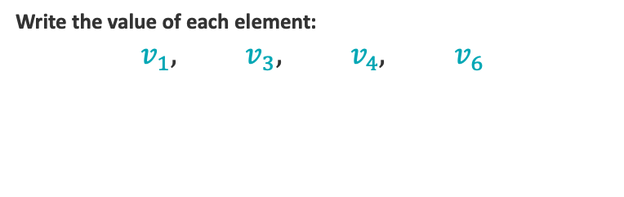

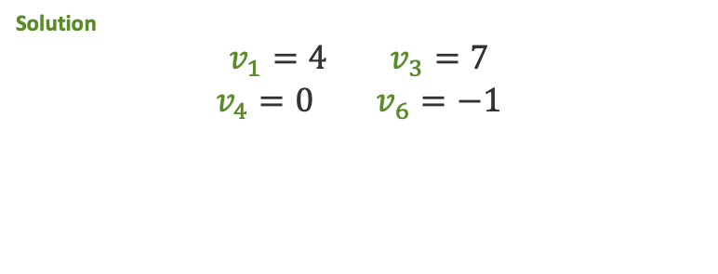
Exercise 6 — Identify vector elements
Read off individual components of a vector using subscript notation.
Given vector
Your task — identify each element
$$v=(4, −2, 7, 0, 5, −1)$$
Write the value of each element:
$$v_{1}, v_{3}, v_{4}, v_{6}$$
A six-component vector. Index the entries left to right as v₁ through v₆.
Solution hidden
Identify each element first, then remove this cover to reveal.
identify
Solution
$$v_{1}=4 v_{3}=7$$
$$v_{4}=0 v_{6}=−1$$
v ∈ ℝ⁶, dim(v) = 6 (six components)
Subscript i selects the i-th component — counting starts at 1, so the first entry is v₁.

Slide 51
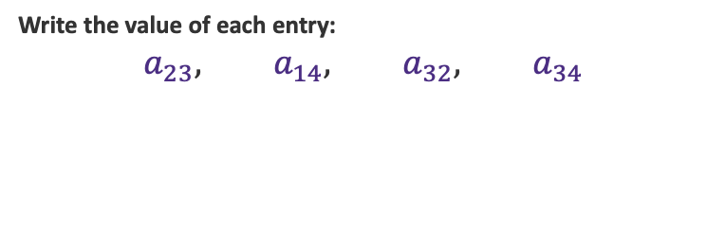

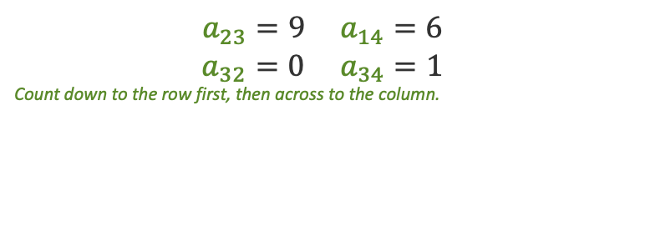
Exercise 7 — Identify matrix elements
Locate individual entries of a matrix using double-subscript notation.
Given matrix
Your task — identify each element
$$A=\left[\begin{matrix}3 & 8 & 1 & 6 \\ 5 & 2 & 9 & 4 \\ 7 & 0 & 2 & 1\end{matrix}\right]$$
Write the value of each entry:
$$a_{23}, a_{14}, a_{32}, a_{34}$$
A 3 × 4 matrix: 3 rows, 4 columns. Read aᵢⱼ as (row i, column j).
Solution hidden — identify each entry first, then remove this cover.
identify
$$a_{23}=9 a_{14}=6$$
$$a_{32}=0 a_{34}=1$$
Count down to the row first, then across to the column.
A ∈ ℝ³ˣ⁴, dim(A) = 3 × 4 (3 rows × 4 columns)
Entry aᵢⱼ sits in row i, column j — row index always comes first.

Slide 52

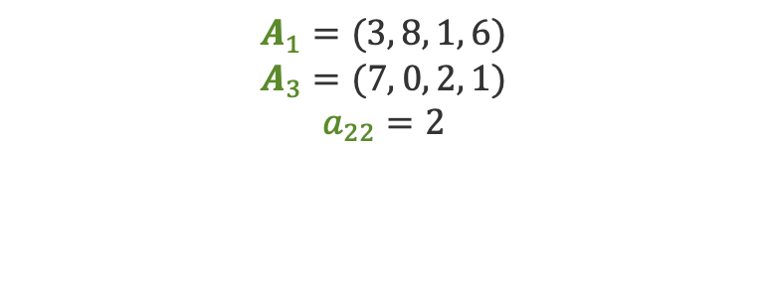
Exercise 8 — Identify matrix rows
Use bold subscript notation to pull out an entire row vector of a matrix.
Given matrix
Your task — identify each row
$$A=\left[\begin{matrix}3 & 8 & 1 & 6 \\ 5 & 2 & 9 & 4 \\ 7 & 0 & 2 & 1\end{matrix}\right]$$
Write out each row vector, then the element:
$$A_{1}, A_{3}, a_{22}$$
A 3 × 4 matrix. Row i is written Aᵢ (bold).
Solution hidden — identify each entry first, then remove this cover.
identify
$$A_{1}=(3, 8, 1, 6)$$
$$A_{3}=(7, 0, 2, 1)$$
$$a_{22}=2$$
A ∈ ℝ³ˣ⁴, dim(A) = 3 × 4 (3 rows × 4 columns)
Bold Aᵢ denotes the whole i-th row vector, while aᵢⱼ is a single scalar entry.

Slide 53
Scalar Multiplication of a Vector
Scaling a vector — multiply every entry by the same number
Definition
α · v = α · (v₁, v₂, ..., vₙ) = (α·v₁, α·v₂, ..., α·vₙ)
α ∈ ℝ is a scalar; v ∈ ℝⁿ is a vector; result has the same dimension as v.
What it does
Geometry
Why it matters
Stretches or shrinks the vector.
• α > 1: stretches (longer)
• 0 < α < 1: shrinks (shorter)
• α = 0: collapses to origin
• α < 0: flips direction
Direction is preserved
(or reversed if α<0).
Magnitude scales by |α|:
‖α·v‖ = |α| · ‖v‖
Building block for:
• Linear combinations
• Gradient updates: θ − η·∇L
• Normalization: v / ‖v‖
• Rescaling features
Key property: ‖α · v‖ = |α| · ‖v‖ — scaling a vector scales its magnitude.
Scalar multiplication = uniform stretch/shrink/flip applied to every coordinate

Slide 54
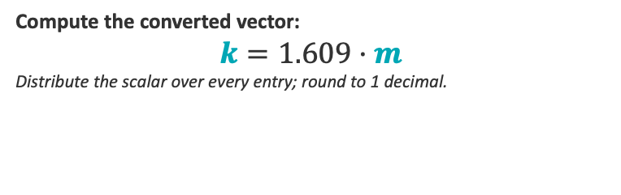

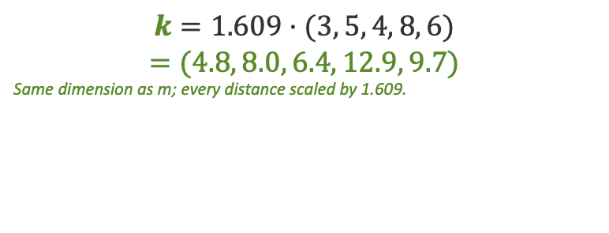
Example 7 — Scale a vector: miles to kilometres
Multiply a real-data vector by a single scalar to convert every entry.
Real data — weekly run (miles per day)
Your task
A runner logs distance each weekday:
$$m=(3, 5, 4, 8, 6)$$
Compute the converted vector:
$$k=1.609·m$$
Distribute the scalar over every entry; round to 1 decimal.
Units: miles. Convert to kilometres using 1 mile = 1.609 km.
Solution hidden — work it out first, then remove this cover.
scale
$$k=1.609·(3, 5, 4, 8, 6)$$
$$=(4.8, 8.0, 6.4, 12.9, 9.7)$$
Same dimension as m; every distance scaled by 1.609.
Scaling by a positive constant stretches the whole vector uniformly — every day's distance grows by the same factor.

Slide 55


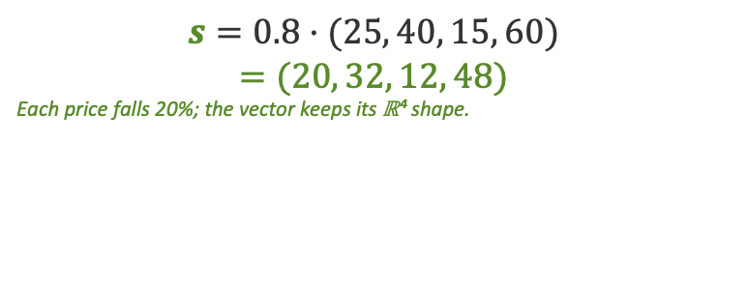
Example 8 — Scale a vector: 20% markdown
A discount applies the same factor to every price — a scalar multiply.
Real data — store prices ($)
Your task
Four catalogue prices, in dollars:
$$p=(25, 40, 15, 60)$$
Compute the sale-price vector:
$$s=0.8·p$$
Apply the scalar 0.8 to every component.
A storewide sale takes 20% off, so each price is multiplied by 0.8.
Solution hidden — work it out first, then remove this cover.
scale
$$s=0.8·(25, 40, 15, 60)$$
$$=(20, 32, 12, 48)$$
Each price falls 20%; the vector keeps its ℝ⁴ shape.
0 < α < 1 shrinks the vector — every price drops by the same proportion while their ratios stay fixed.

Slide 56
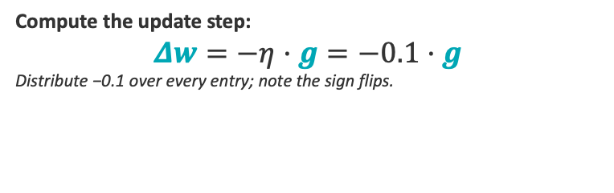

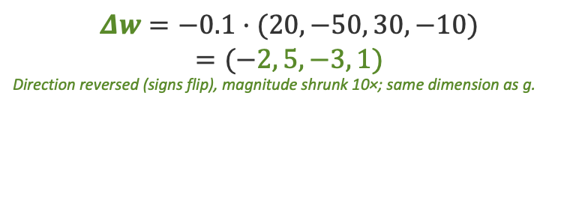
Example 9 — Scale a vector: one gradient-descent step
A negative scalar flips direction and shrinks — the core of a gradient update.
Real data — loss gradient at current weights
Your task
Back-prop returns the loss gradient:
$$g=(20, −50, 30, −10)$$
Compute the update step:
$$Δw=−η·g=−0.1·g$$
Distribute −0.1 over every entry; note the sign flips.
Learning rate η = 0.1. The weight update subtracts a scaled gradient.
Solution hidden — work it out first, then remove this cover.
step
$$Δw=−0.1·(20, −50, 30, −10)$$
$$=(−2, 5, −3, 1)$$
Direction reversed (signs flip), magnitude shrunk 10×; same dimension as g.
The negative scalar −η flips the gradient and shrinks it — direction reverses, length scales by η.

Slide 57
Visual — Scalar Multiplication in 2D
α·v stretches, shrinks, or flips a vector — direction is preserved (or reversed)
y
What's happening
Base: v = (2, 1)
2·v = (4, 2)
the reference vector
2·v = (4, 2)
stretched 2× — same direction
½·v = (1, 0.5)
v = (2, 1)
shrunk to half length
½·v = (1, 0.5)
−v = (−2, −1)
0
x
flipped 180° — opposite direction
−v = (−2, −1)
Rule: ‖α·v‖ = |α|·‖v‖
magnitude scales by |α|; sign of α controls direction.
All scaled vectors lie on the same line through the origin.
Scalar multiplication = uniform stretch / shrink / flip along the vector's direction

Slide 58
Scalar Multiplication — Example 1 of 3
Compute the result of scaling a 3-dimensional vector
Question
Let α = 3 and v = (2, −1, 4).
Compute α · v.
Solution (hidden — click or reveal in presentation mode)
Apply the scalar to each component:
3 · (2, −1, 4) = (3·2, 3·(−1), 3·4)
= (6, −3, 12)
Check magnitude: ‖v‖ = √(4+1+16) = √21 → ‖3v‖ = 3√21 = √189 ✓
Answer: α · v = (6, −3, 12)
Each entry multiplied by α = 3 — direction unchanged, length tripled

Slide 59
Example 2 — Scalar Multiplication
Scaling a probability-like vector by ½
Question
Compute α · v where α = ½ and v = (0.6, 0.8, 0.4)
Solution (hidden until reveal)
Step 1. Apply the scalar to each component:
α · v = ½ · (0.6, 0.8, 0.4) = (½·0.6, ½·0.8, ½·0.4)
= (0.3, 0.4, 0.2)
Check magnitude: ‖α·v‖ = |α|·‖v‖ = ½·√(0.36+0.64+0.16) = ½·√1.16 ≈ 0.539
Answer: α · v = (0.3, 0.4, 0.2)
Halving every entry halves the vector's magnitude — direction preserved

Slide 60
Example 3 — Scalar Multiplication
Negative scalar — flipping direction in a gradient-descent step
Question
A gradient step uses α = −0.1 and ∇L = (5, −2, 3, 1).
Compute the update vector α · ∇L (i.e. θ_new − θ_old).
Solution (hidden until reveal)
Step 1. Multiply each component by −0.1:
−0.1 · (5, −2, 3, 1) = (−0.1·5, −0.1·(−2), −0.1·3, −0.1·1)
= (−0.5, 0.2, −0.3, −0.1)
Geometric note: the negative sign flips the gradient direction — we step downhill.
Answer: α · ∇L = (−0.5, 0.2, −0.3, −0.1)
Negative scalars reverse direction — this is exactly how gradient descent moves opposite the gradient

Slide 61
Scalar Addition / Subtraction with a Vector
Broadcasting — add (or subtract) the same number to every entry
Definition (broadcasted operation)
v + α = (v₁ + α, v₂ + α, ..., vₙ + α) v − α = (v₁ − α, v₂ − α, ..., vₙ − α)
Strictly, this is broadcasting — not a textbook vector-space op. NumPy/PyTorch/TensorFlow all support it.
What it does
Geometry
Why it matters
Adds (or subtracts) the same constant to every component.
Result dimension = same as v.
Translates the vector by α along the all-ones direction (1,1,...,1).
Direction and magnitude both change.
Used for:
• Mean-centering: x − μ
• Bias addition in neural nets
• Image brightness shift
• Affine transformations
Key idea: v ± α shifts every coordinate by the same amount — it's a translation, not a scaling.
Adding a scalar = uniform shift on every entry (broadcasting)

Slide 62
Scalar Addition / Subtraction — 2D Visual
Adding a scalar to a vector shifts every coordinate equally — a uniform translation
Geometry of v ± α
v + 2 = (4, 3)
Original vector
v = (2, 1)
+α in y
Add scalar α = 2
v = (2, 1)
v + 2 = (4, 3)
+α in x
Subtract scalar α = 2
v − 2 = (0, −1)
Broadcasting:
α is added to every component
of v — neither direction nor
shape is preserved, the entire
vector shifts uniformly
along (1, 1, …, 1).
v − 2 = (0, −1)
v ± α = uniform translation along the diagonal — every coordinate moves by the same amount

Slide 63
Example 1 — Scalar Addition to a Vector
Centering by adding a scalar to every coordinate
Question
Compute v + α where v = (3, 7, 1, 5) and α = -4
Solution (hidden until reveal)
Step 1. Add the scalar (-4) to each component (broadcasting):
v + α = (3 + (-4), 7 + (-4), 1 + (-4), 5 + (-4))
= (-1, 3, -3, 1)
Geometric reading: every entry shifted left by 4 — same vector translated, magnitude changes.
Answer: v + α = (-1, 3, -3, 1)
Adding a scalar = uniform shift along every dimension

Slide 64
Example 2 — Scalar Add/Sub with a Vector
Mean-centering: subtract the mean from every entry
Question
Center the score vector s = (8, 6, 10, 4) by subtracting its mean.
Compute s − μ where μ = mean(s).
Solution (hidden until reveal)
Step 1. Mean: μ = (8+6+10+4)/4 = 28/4 = 7.
Step 2. Subtract μ from each entry:
s − μ = (8−7, 6−7, 10−7, 4−7) = (1, −1, 3, −3)
Check: the entries of the centered vector sum to 0 (1 − 1 + 3 − 3 = 0). ✓
Answer: s − μ = (1, −1, 3, −3)
Subtracting the mean shifts a feature so it's centered at zero — a standard preprocessing step

Slide 65
Example 3 — Scalar Add/Sub with a Vector
Shifting temperature data: the +32 offset in the °C → °F conversion
Question
Daily highs (°C): t = (18, 21, 19, 22, 20). Add 32 to every entry (the offset step of F = 1.8C + 32).
Compute t + 32.
Solution (hidden until reveal)
Step 1. Broadcast the scalar to a vector of equal length: 32 → (32, 32, 32, 32, 32).
Step 2. Add element-wise:
t + 32 = (18+32, 21+32, 19+32, 22+32, 20+32)
= (50, 53, 51, 54, 52)
Answer: t + 32 = (50, 53, 51, 54, 52)
Adding a scalar shifts every entry by the same amount — differences between entries are preserved, the level moves

Slide 66


$$Exercise — Broadcasting: plot v+α$$
Plot the three original vectors on the BEFORE grid, then plot each shifted vector on the AFTER grid.
$$a=(1, 2) b=(2, 1) c=(0, 3)$$
$$α=2$$
$$Compute v+α for each, then plot on the AFTER grid.$$
BEFORE — you plot a, b, c here
AFTER — solution: a+α, b+α, c+α
y
Solution hidden
Plot the shifted points yourself, then remove this cover to check.
6
6
y
c+α
5
5
a+α
4
4
c
$$v+α$$
b+α
3
3
a
2
2
b
1
1
x
x
0
1
2
3
4
5
6
0
1
2
3
4
5
6
$$Adding a scalar shifts every point diagonally by (α, α) — up−and−right — keeping the cloud′s shape.$$

Slide 67





Exercise — Broadcasting: plot $v−α$
Plot the three original vectors on the BEFORE grid, then plot each shifted vector v − α on the AFTER grid.
$$a=(3, 4) b=(4, 3) c=(2, 5)$$
$$α=2$$
$$Compute v−α for each, then plot the shifted points.$$
BEFORE — plot a, b, c
AFTER — plot a−α, b−α, c−α
y
Solution hidden
Plot the shifted points yourself, then remove this cover to check.
6
6
y
c
5
5
a
4
4
b
$$v−α$$
$$c−α$$
3
3
$$a−α$$
2
2
$$b−α$$
1
1
x
x
0
1
2
3
4
5
6
0
1
2
3
4
5
6
Subtracting a scalar from every component shifts the whole point diagonally by (−α, −α) — here down-and-left — preserving the shape of the cloud.

Slide 68
Vector Addition & Subtraction
Combining two vectors entry-by-entry — only defined when dimensions match
Definition
u + v = (u₁+v₁, u₂+v₂, ..., uₙ+vₙ) u, v ∈ ℝⁿ
Same shape in → same shape out. Subtraction is u − v = u + (−1)·v.
What it does
Geometry
Why it matters
Combine two vectors component-by-component.
• Add: element-wise sum
• Subtract: element-wise difference
Result lives in the same ℝⁿ.
Parallelogram rule:
place v at the tip of u
— resulting tip is u + v.
u − v points from v's tip
to u's tip.
Commutative: u + v = v + u.
Building block for:
• Mean & sum of vectors
• Differences between
observations
• Translating embeddings
• Residuals: y − ŷ
• Gradient + parameter update
Constraint: u and v must have the same dimension n. Result ∈ ℝⁿ.
Vector addition is the engine of every linear combination

Slide 69
Vector Addition — Parallelogram Rule (2D)
u + v completes the parallelogram with u and v as two sides
u + v = (4, 4)
Parallelogram rule
u (shifted)
Step 1. Draw both vectors from origin O.
v (shifted)
Step 2. Translate v to start at tip of u
(or u to tip of v).
v = (1, 3)
Step 3. The sum u + v points from O to
the far corner of the parallelogram.
u = (3, 1)
Algebraically:
(u₁+v₁, u₂+v₂) = (3+1, 1+3) = (4, 4)
O
Subtraction u − v works the same way
but translates −v instead of v.
Commutative: u + v = v + u
Associative: (u+v)+w = u+(v+w)
Vector addition = tip-to-tail translation — the sum closes the parallelogram

Slide 70
Example 1 — Vector Addition
Adding two 3-dimensional vectors
Question
Let u = (2, 5, −1) and v = (4, −3, 7).
Compute u + v.
Solution (hidden until reveal)
Step 1. Check dimensions: dim(u) = dim(v) = 3. ✓
Step 2. Add entry-by-entry:
u + v = (2+4, 5+(−3), −1+7)
= (6, 2, 6)
Answer: u + v = (6, 2, 6)
Same dimension in, same dimension out — combine coordinates entry-by-entry

Slide 71
Example 2 — Vector Subtraction
Residuals — predicted vs. actual
Question
True labels: y = (3.0, 5.5, 2.0, 4.5). Predictions: ŷ = (2.8, 5.0, 2.3, 4.6).
Compute the residual vector r = y − ŷ.
Solution (hidden until reveal)
Step 1. Both vectors are in ℝ⁴ — subtraction is well-defined.
Step 2. Subtract entry-by-entry:
r = (3.0−2.8, 5.5−5.0, 2.0−2.3, 4.5−4.6)
= (0.2, 0.5, −0.3, −0.1)
Interpretation: positive r means prediction was too low; negative means too high.
Answer: r = y − ŷ = (0.2, 0.5, −0.3, −0.1)
Vector subtraction gives the residual — exactly what regression and gradient descent operate on

Slide 72
Example 3 — Linear Combination
Scalar multiplication + addition working together
Question
Let u = (1, 2), v = (3, −1). Compute the linear combination
2·u + 3·v.
Solution (hidden until reveal)
Step 1. Scale each vector first:
2·u = 2·(1, 2) = (2, 4) 3·v = 3·(3, −1) = (9, −3)
Step 2. Add the scaled vectors:
2·u + 3·v = (2+9, 4+(−3)) = (11, 1)
Answer: 2·u + 3·v = (11, 1)
Every linear model output is a linear combination of input feature vectors

Slide 73


Exercise — Vector addition: plot $u+v$
Plot u and v from the origin on the GIVEN grid, then add them tip-to-tail and plot u + v on the SUM grid.
$$u=(1, 3) v=(4, 1)$$
$$Compute u+v=(u₁+v₁, u₂+v₂), then plot it.$$
GIVEN — plot u, v
SUM — draw u + v
y
Solution hidden
Plot the shifted points yourself, then remove this cover to check.
6
6
y
5
5
$$u+v$$
4
4
3
$$u+v$$
3
2
2
1
1
x
x
0
1
2
3
4
5
6
0
1
2
3
4
5
6
Tip-to-tail: slide v so its tail sits on u's tip — the arrow from the origin to that new tip is u + v, the diagonal of the parallelogram.

Slide 74
Exercise — Vector addition: plot $u+v$
Plot u and v from the origin on the GIVEN grid, then add them tip-to-tail and plot u + v on the SUM grid.
$$u=(2, 1) v=(1, 4)$$
$$Compute u+v=(u₁+v₁, u₂+v₂), then plot it.$$
GIVEN — plot u, v
SUM — draw u + v
y
Solution hidden
Plot the shifted points yourself, then remove this cover to check.
6
6
y
$$u+v$$
5
5
4
4
3
$$u+v$$
3
2
2
1
1
x
x
0
1
2
3
4
5
6
0
1
2
3
4
5
6
Tip-to-tail: slide v so its tail sits on u's tip — the arrow from the origin to that new tip is u + v, the diagonal of the parallelogram.

Slide 75
Dot Product (Inner Product)
Multiplying two vectors to get one number — the most-used operation in ML
Definition
u · v = Σᵢ uᵢ vᵢ = u₁v₁ + u₂v₂ + ... + uₙvₙ
u, v ∈ ℝⁿ (same dimension); result is a scalar in ℝ; geometrically: u·v = ‖u‖·‖v‖·cosθ
What it does
Geometry
Why it matters
Combines two vectors into a single scalar.
• Pairs entries by index
• Multiplies pairs
• Sums them all up
Measures alignment.
u · v = ‖u‖·‖v‖·cosθ
• > 0: vectors point similar way
• = 0: vectors orthogonal (90°)
• < 0: point opposite ways
Projection of u onto v.
Used in:
• Cosine similarity (recsys, NLP)
• Neural net weighted sums
• Loss functions (MSE expands)
• Projections, attention scores
• Linear regression: ŷ = x · β
cos θ = (u · v) / (‖u‖ · ‖v‖) — normalized dot product gives cosine similarity
The dot product converts a pair of vectors into a single number that measures their alignment

Slide 76
Dot Product — Projection View (2D)
u · v = ‖u‖·‖v‖·cos θ — geometrically, projection of one vector onto the other
Geometric meaning
u · v = ‖u‖ · ‖v‖ · cos θ
= length of u's shadow along v
× length of v
u = (4, 3)
For u=(4,3), v=(5,1):
u · v = 4·5 + 3·1 = 23
‖u‖ = 5, ‖v‖ ≈ 5.10
cos θ = 23/(5·5.10) ≈ 0.902
θ ≈ 25.6°
v = (5, 1)
Sign tells us:
• u·v > 0 → acute (same side)
• u·v = 0 → perpendicular
• u·v < 0 → obtuse (opposite)
θ
proj_v(u)
O
Dot product = how much of u points in the direction of v, scaled by ‖v‖

Slide 77
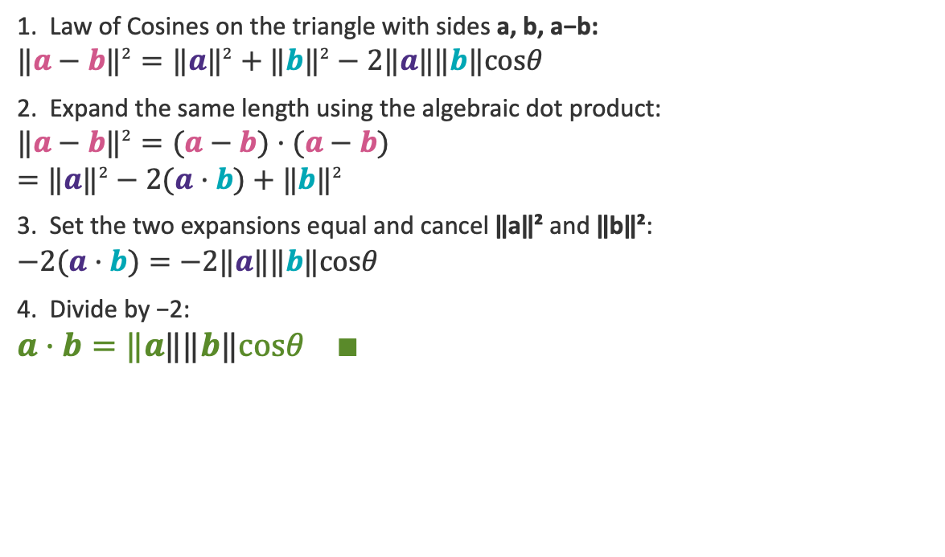




Proof: $a·b=‖a‖‖b‖cosθ$
Two routes to the same scalar — the algebraic definition and the Law of Cosines must agree.
1. Law of Cosines on the triangle with sides a, b, a−b:
$${‖a−b‖}^{2}={‖a‖}^{2}+{‖b‖}^{2}−2‖a‖‖b‖cosθ$$
2. Expand the same length using the algebraic dot product:
$${‖a−b‖}^{2}=(a−b)·(a−b)$$
$$={‖a‖}^{2}−2(a·b)+{‖b‖}^{2}$$
3. Set the two expansions equal and cancel ‖a‖² and ‖b‖²:
$$−2(a·b)=−2‖a‖‖b‖cosθ$$
4. Divide by −2:
$$a·b=‖a‖‖b‖cosθ ∎$$
Setup
$$b$$
$$a−b$$
Why this matters: the component formula a·b = a₁b₁ + a₂b₂ and the geometric form ‖a‖‖b‖cos θ are the SAME number — so the dot product measures both coordinates and angle at once.
$$θ$$
$$a$$
O
The third side is a−b; θ is the angle at O.
Computing the squared length of a − b two ways forces the algebraic and geometric dot products to coincide.

Slide 78
Example 1 — Dot Product
Straight computation: u · v
Question
Compute u · v where u = (2, 3, -1) and v = (4, 0, 5)
Solution (hidden until reveal)
Step 1. Multiply paired entries: (2·4), (3·0), (-1·5)
= 8, 0, -5
Step 2. Sum the products: 8 + 0 + (-5) = 3
Sanity: ‖u‖ ≈ 3.74, ‖v‖ ≈ 6.40, so cosθ = 3 / (3.74·6.40) ≈ 0.125 (mostly orthogonal).
Answer: u · v = 3
Dot product = pair-multiply, then sum — three multiplications and two additions for ℝ³

Slide 79
Example 2 — Orthogonality Check
Use the dot product to test if two vectors are perpendicular
Question
Are u = (1, 2, -2) and v = (4, -1, 1) orthogonal?
Solution (hidden until reveal)
Step 1. Two vectors are orthogonal iff their dot product = 0.
u · v = (1)(4) + (2)(-1) + (-2)(1) = 4 − 2 − 2 = 0
Step 2. Conclusion: u · v = 0, so the vectors are orthogonal (perpendicular).
Geometric meaning: the angle between them is exactly 90°.
Answer: Yes — u ⊥ v
Orthogonality is decided by one scalar: if u · v = 0, the vectors meet at a right angle

Slide 80




Exercise — Dot product: compute $u·v$
The two vectors are drawn from the origin on the grid. Compute their dot product.
$$u=(3, 1) v=(1, 2)$$
$$Find u·v = u₁v₁ + u₂v₂.$$
u, v drawn from the origin
Solution hidden
Compute the dot product yourself, then remove this cover to check.
6
y
$$u·v=(3)(1)+(1)(2)=5$$
5
Projection of v onto u
4
Magenta = proj of v onto u
3
u·v = |u| × (length of projection)
2
$$v$$
$$v$$
1
$$u$$
$$u$$
x
0
1
2
3
4
5
6
Dot product: $u·v=u₁v₁+u₂v₂ — a single number, not a vector.$

Slide 81




Exercise — Dot product: compute $u·v$
The two vectors are drawn from the origin on the grid. Compute their dot product.
$$u=(2, 3) v=(4, 1)$$
$$Find u·v = u₁v₁ + u₂v₂.$$
u, v drawn from the origin
Solution hidden
Compute the dot product yourself, then remove this cover to check.
6
y
$$u·v=(2)(4)+(3)(1)=11$$
5
4
proj of v onto u (highlighted)
u·v = |u| × (length of projection)
3
$$u$$
2
$$u$$
1
$$v$$
$$v$$
x
0
1
2
3
4
5
6
Dot product: $u·v=u₁v₁+u₂v₂ — a single number, not a vector.$

Slide 82



Exercise — Dot product: compute $u·v$
The two vectors are drawn from the origin on the grid. Compute their dot product.
$$u=(1, 4) v=(2, 1)$$
$$Find u·v = u₁v₁ + u₂v₂.$$
u, v drawn from the origin
Solution hidden
Compute the dot product yourself, then remove this cover to check.
6
y
$$u·v=(1)(2)+(4)(1)=6$$
5
Projection of v onto u
4
$$u$$
Magenta = proj of v onto u
3
u·v = |u| × (length of projection)
$$u$$
2
1
$$v$$
$$v$$
x
0
1
2
3
4
5
6
Dot product: $u·v=u₁v₁+u₂v₂ — a single number, not a vector.$

Slide 83
Norm of a Vector
Measuring the size or length of a vector
Definition (Euclidean / L² norm)
‖v‖ = √(v₁² + v₂² + … + vₙ²)
A norm is a non-negative scalar that quantifies the magnitude of a vector — always ≥ 0, equals 0 only at the origin.
What it measures
Three axioms
Why it matters
The length (magnitude) of a
vector — how far it reaches
from the origin.
For v = (3, 4):
‖v‖ = √(9 + 16) = √25 = 5
1. ‖v‖ ≥ 0; ‖v‖=0 iff v=0
2. ‖α·v‖ = |α|·‖v‖
(absolute homogeneity)
3. ‖u + v‖ ≤ ‖u‖ + ‖v‖
(triangle inequality)
• Distance: d(u,v) = ‖u − v‖
• Normalization: v̂ = v / ‖v‖
• Loss functions (MSE, L1)
• Regularization (ridge, lasso)
• Convergence criteria in ML
Key insight: ‖v‖² = v · v — the norm squared is the dot product of v with itself.
The norm turns a vector into a single number — its length — and underlies every notion of distance

Slide 84
Norm — 2D Visual
The norm is the hypotenuse of a right triangle made of v's components
y
Geometry of the norm
5
Vector
v = (3, 4)
4
Components form the legs
v₁ = 3, v₂ = 4
3
Apply Pythagoras
‖v‖ = 5
‖v‖² = 3² + 4²
2
v₂ = 4
‖v‖ = √25 = 5
Key intuition
The norm IS the hypotenuse —
the straight-line length from the
origin to the tip of v.
In ℝⁿ: same idea, more legs.
1
x
0
1
2
3
4
5
v₁ = 3
‖v‖ = √(v₁² + v₂²) — the Pythagorean theorem applied to a vector's coordinates

Slide 85
Example 1 — Compute the Norm
A simple 2-vector — verify by Pythagoras
Question
Compute ‖v‖ for v = (5, 12)
Solution (hidden until reveal)
Step 1. Square each component: 5² = 25, 12² = 144
Step 2. Sum: 25 + 144 = 169
Step 3. Take the square root: ‖v‖ = √169 = 13
Geometric check: (5, 12, 13) is a classic Pythagorean triple.
Answer: ‖v‖ = 13
Square, sum, root — the L² norm in three steps

Slide 86
Example 2 — Compute the Norm
Same recipe in higher dimensions — and normalize to a unit vector
Question
Compute ‖u‖ and the unit vector û = u / ‖u‖ for u = (2, −2, 1)
Solution (hidden until reveal)
Step 1. Square components: 2² = 4, (−2)² = 4, 1² = 1
Step 2. Sum and root: ‖u‖ = √(4 + 4 + 1) = √9 = 3
Step 3. Divide each component by ‖u‖: û = (2/3, −2/3, 1/3)
Check: ‖û‖ = √(4/9 + 4/9 + 1/9) = √1 = 1 ✓ (unit length, as required)
Answer: ‖u‖ = 3, û = (2/3, −2/3, 1/3)
Dividing by ‖v‖ produces a unit vector — same direction, length 1

Slide 87
Example 3 — Norm as Distance
Use the norm of a difference to measure the distance between two points
Question
Compute the distance d(p, q) = ‖p − q‖ for p = (1, 7, 3, 2) and q = (4, 3, 0, 4)
Solution (hidden until reveal)
Step 1. Subtract componentwise: p − q = (1−4, 7−3, 3−0, 2−4) = (−3, 4, 3, −2)
Step 2. Square each: (−3)² = 9, 4² = 16, 3² = 9, (−2)² = 4
Step 3. Sum and root: ‖p − q‖ = √(9 + 16 + 9 + 4) = √38 ≈ 6.16
Note: the result is symmetric — ‖p − q‖ = ‖q − p‖, since squaring kills the sign.
Answer: d(p, q) = √38 ≈ 6.16
d(p, q) = ‖p − q‖ — the norm of the difference IS the Euclidean distance

Slide 88
Cosine Similarity
Measuring similarity by direction, not magnitude — the workhorse of NLP and recommendation systems
Definition
cos(θ) = (u · v) / (‖u‖ · ‖v‖)
Take the dot product, divide by the product of magnitudes. Result lives in [−1, 1].
What it captures
Geometry
Why it matters
The cosine of the angle between
two vectors.
• +1 → same direction
• 0 → perpendicular (unrelated)
• −1 → opposite direction
Magnitude is normalized away.
Project u onto v and measure
how much they align.
Long & short vectors with the
same direction get score 1 —
only angle matters, not length.
Scale-invariant similarity.
Used everywhere similarity
matters but length doesn't:
• Document similarity (TF-IDF)
• Word & sentence embeddings
• Recommender systems
• Face/image retrieval
• Nearest-neighbor in ML
Key insight: cos(θ) ignores ‖u‖ and ‖v‖ — only the angle between u and v decides similarity.
Cosine similarity = angle-based similarity, scale-invariant, bounded in [−1, 1]

Slide 89
Cosine Similarity — 2D Geometric Intuition
Three pairs of vectors at different angles → three similarity scores
Aligned (θ ≈ 25°)
Orthogonal (θ = 90°)
Opposite (θ ≈ 155°)
v
v
u
u
u
θ
θ
θ
v
cos θ ≈ 0.91
cos θ = 0
cos θ ≈ −0.91
Read the picture:
Vectors u and v have the same length in all three plots — only the angle changes. Cosine similarity tracks that angle alone: small angle ⇒ high score, perpendicular ⇒ zero, pointing apart ⇒ negative. Lengths could be 1 or 100 — the score stays the same.
Same angle, same cosine similarity — magnitudes cancel out of the formula

Slide 90
Example 3 — Cosine Similarity
Two document term-count vectors — how similar are they?
Question
Compute cosine similarity between u = (3, 4) and v = (4, 3).
Solution (hidden until reveal)
Step 1. Dot product: u · v = (3)(4) + (4)(3) = 12 + 12 = 24
Step 2. Norms: ‖u‖ = √(9+16) = 5 ‖v‖ = √(16+9) = 5
Step 3. cosθ = (u · v) / (‖u‖·‖v‖) = 24 / (5·5) = 24/25 = 0.96
Interpretation: 0.96 is very close to 1 → vectors point in nearly the same direction (θ ≈ 16°).
Answer: cos θ ≈ 0.96 (highly similar)
Cosine similarity = normalized dot product — the workhorse metric for text, embeddings, and recs

Slide 91
Hadamard (Element-wise) Product
Multiply vectors entry-by-entry — same dimension, same shape result
Definition
u ⊙ v = (u₁·v₁, u₂·v₂, ..., uₙ·vₙ)
u, v ∈ ℝⁿ — result is a vector in ℝⁿ (not a scalar like the dot product).
What it does
vs. Dot product
Why it matters
Independent gating per dimension.
• Each entry scaled separately
• Result stays in ℝⁿ
• Dimensions must match
• Commutes: u ⊙ v = v ⊙ u
Dot: scalar Σ uᵢvᵢ
Hadamard: vector (uᵢvᵢ)
Dot collapses; Hadamard keeps structure.
Notation: u ⊙ v
Neural networks:
• Element-wise activations
• Gating in LSTM/GRU/GLU
• Masked attention
• Dropout masks
• Feature-wise modulation
Key idea: element-wise — no sum, no projection, just pairwise products.
Hadamard product = a vector where each entry multiplies its counterpart

Slide 92
Hadamard (Element-wise) Product — 2D Visual
u ⊙ v multiplies coordinates one-by-one — anisotropic scaling along each axis
Element-by-element
(u ⊙ v)ᵢ = uᵢ · vᵢ
Multiply coordinate-by-coordinate.
Result has same dimension as inputs.
u = (2, 3)
u ⊙ v = (6, 3)
For u=(2,3), v=(3,1):
y: 3 × 1 = 3
(u ⊙ v)₁ = 2 · 3 = 6
(u ⊙ v)₂ = 3 · 1 = 3
u ⊙ v = (6, 3)
Geometry: v acts as a per-axis
scaling factor on u.
• x-axis stretched by vₓ = 3
• y-axis stretched by vᵧ = 1
Not the same as dot product —
result is a vector, not a scalar.
v = (3, 1)
O
x: 2 × 3 = 6
Hadamard = independent scaling on each axis — the diagonal version of matrix multiplication

Slide 93
Example 1 — Hadamard Product
Basic element-wise multiplication of two 3-D vectors
Question
Compute u ⊙ v where u = (2, 5, -1) and v = (3, 4, 6)
Solution (hidden until reveal)
Step 1. Pair entries by index: (u₁,v₁), (u₂,v₂), (u₃,v₃) = (2,3), (5,4), (-1,6)
Step 2. Multiply each pair: 2·3 = 6, 5·4 = 20, (-1)·6 = -6
Step 3. Assemble as a vector: u ⊙ v = (6, 20, -6)
Check shape: u, v ∈ ℝ³ → u ⊙ v ∈ ℝ³. ✓
Answer: u ⊙ v = (6, 20, -6)
Hadamard: pair, multiply, assemble — same dimension out

Slide 94
Example 2 — Hadamard Product
Applying a dropout mask — gating an activation vector
Question
Apply mask m = (1, 0, 1, 1, 0) to activations a = (0.8, 0.4, 0.9, 0.2, 0.7). Compute a ⊙ m.
Solution (hidden until reveal)
Step 1. Multiply entry-by-entry — entries where mᵢ = 0 are killed:
0.8·1 = 0.8, 0.4·0 = 0, 0.9·1 = 0.9, 0.2·1 = 0.2, 0.7·0 = 0
Step 2. Assemble: a ⊙ m = (0.8, 0, 0.9, 0.2, 0)
Interpretation: positions 2 and 5 were 'dropped' — the rest pass through unchanged.
Answer: a ⊙ m = (0.8, 0, 0.9, 0.2, 0)
Hadamard with a 0/1 mask = gating: keep or kill each coordinate

Slide 95
Example 3 — Hadamard Product
Per-feature scaling — different gain per dimension
Question
Scale features x = (10, 5, 2, 8) by per-feature gains g = (0.1, 2, 5, 0.5). Compute x ⊙ g.
Solution (hidden until reveal)
Step 1. Multiply entry-by-entry — each feature gets its own scale:
10·0.1 = 1, 5·2 = 10, 2·5 = 10, 8·0.5 = 4
Step 2. Assemble: x ⊙ g = (1, 10, 10, 4)
Note: feature 1 was shrunk 10×, features 2 and 3 amplified, feature 4 halved — independent per dim.
Answer: x ⊙ g = (1, 10, 10, 4)
Hadamard lets each coordinate carry its own multiplier — perfect for feature-wise gain

Slide 96




Exercise — Hadamard product: plot $a⊙b$
a and b are drawn on the BEFORE grid. Multiply them element-by-element and plot the result on the AFTER grid.
$$a=(2, 3) b=(3, 1)$$
$$a⊙b=(a₁b₁, a₂b₂), then plot it.$$
BEFORE — a, b drawn from origin
AFTER — plot a ⊙ b
y
Solution hidden
Compute a ⊙ b yourself, then remove this cover to check.
6
6
y
5
5
4
4
$$a$$
$$a⊙b$$
$$a⊙b$$
3
3
2
2
1
$$b$$
1
x
x
0
1
2
3
4
5
6
0
1
2
3
4
5
6
The Hadamard product multiplies matching components: each axis is scaled independently — it is NOT the dot product and stays a vector.

Slide 97




Exercise — Hadamard product: plot $a⊙b$
a and b are drawn on the BEFORE grid. Multiply them element-by-element and plot the result on the AFTER grid.
$$a=(1, 4) b=(4, 1)$$
$$Compute a⊙b=(a₁b₁, a₂b₂), then plot it.$$
BEFORE — a, b drawn from origin
AFTER — plot a ⊙ b
y
Solution hidden
Compute a ⊙ b yourself, then remove this cover to check.
6
6
y
5
5
$$a$$
$$a⊙b$$
4
4
3
$$a⊙b$$
3
2
2
1
$$b$$
1
x
x
0
1
2
3
4
5
6
0
1
2
3
4
5
6
The Hadamard product multiplies matching components: each axis is scaled independently — it is NOT the dot product and stays a vector.

Slide 98
Cross Product (3D only)
Two 3D vectors → a third vector perpendicular to both
Definition
u × v = (u₂v₃ − u₃v₂, u₃v₁ − u₁v₃, u₁v₂ − u₂v₁)
Defined only for u, v ∈ ℝ³. Result is a vector (unlike the dot product, which is a scalar).
What it does
Direction
Why it matters
Produces a vector u × v that is
perpendicular to both u and v.
‖u × v‖ = ‖u‖·‖v‖·|sin θ|
Magnitude = area of the
parallelogram formed by u and v.
Right-hand rule.
u × v = −(v × u)
(it is anti-commutative).
u × u = 0
u × v = 0 ⇔ u ∥ v
• Surface normals in 3D graphics
• Torque τ = r × F
• Angular momentum L = r × p
• Plane orientation in geometry
• Building orthonormal frames
‖u × v‖ = ‖u‖·‖v‖·sin θ — measures how 'non-parallel' two vectors are.
Cross product = perpendicular vector whose length = parallelogram area

Slide 99
Cross Product — Right-Hand Rule (pseudo-3D)
u × v produces a vector perpendicular to both — pointing out of the (u, v) plane
Right-hand rule
u × v
Direction:
Curl right-hand fingers from u
toward v — thumb points along u×v.
Magnitude:
‖u × v‖ = ‖u‖ · ‖v‖ · sin θ
= area of the parallelogram
v
(u, v) plane
Key properties:
u
• u × v = − (v × u) (anti-commutative)
• u × u = 0 (parallel → zero)
• Only defined in 3D (and 7D)
• Distributive: u × (v + w) = u×v + u×w
Uses: torque, angular momentum,
normals to surfaces, 3D rotation axes.
Cross product = vector perpendicular to both inputs, with magnitude = parallelogram area

Slide 100
Example 1 — Cross Product
General vectors in 3D
Question
Compute u × v where u = (1, 2, 3) and v = (4, 5, 6)
Solution (hidden until reveal)
Apply the formula u × v = (u₂v₃−u₃v₂, u₃v₁−u₁v₃, u₁v₂−u₂v₁)
(u × v)₁ = 2·6 − 3·5 = 12 − 15 = −3
(u × v)₂ = 3·4 − 1·6 = 12 − 6 = 6
(u × v)₃ = 1·5 − 2·4 = 5 − 8 = −3
Check perpendicularity: u·(u×v) = 1(−3)+2(6)+3(−3) = 0 ✓
Answer: u × v = (−3, 6, −3)
Result is perpendicular to both inputs — verified by dot products being 0

Slide 101
Example 2 — Cross Product (Standard Basis)
i × j: foundation of the right-hand rule
Question
Compute i × j where i = (1, 0, 0) and j = (0, 1, 0). What about j × i?
Solution (hidden until reveal)
Components of i × j:
(i × j)₁ = 0·0 − 0·1 = 0 (i × j)₂ = 0·0 − 1·0 = 0 (i × j)₃ = 1·1 − 0·0 = 1
So i × j = (0, 0, 1) = k — the third standard basis vector (z-axis).
By anti-commutativity: j × i = −(i × j) = (0, 0, −1) = −k
Answer: i × j = k and j × i = −k
Swapping the order of a cross product flips its direction

Slide 102
Example 3 — Parallelogram Area via Cross Product
Geometric interpretation of ‖u × v‖
Question
Find the area of the parallelogram spanned by u = (2, 0, 0) and v = (0, 3, 4).
Solution (hidden until reveal)
Step 1. Compute u × v.
u × v = (0·4 − 0·3, 0·0 − 2·4, 2·3 − 0·0) = (0, −8, 6)
Step 2. Area = ‖u × v‖ = √(0² + 64 + 36) = √100 = 10
Cross-check: ‖u‖·‖v‖·sin θ = 2·5·1 = 10 (since u ⊥ v, sin θ = 1).
Answer: Area = 10 square units
‖u × v‖ literally equals the area of the parallelogram formed by u and v

Slide 103
Visualizing the Parallelogram Spanned by u and v
Geometric view of u = (2, 0, 0) and v = (0, 3, 4) — the area equals ‖u × v‖
z
v = (0, 3, 4)
Area = ‖u × v‖
u × v = (0, –8, 6)
‖u × v‖ = √(0² + 8² + 6²)
= √(64 + 36) = √100
u × v = (0, –8, 6)
Area = 10 square units
y
u = (2, 0, 0)
x
The magnitude of the cross product ‖u × v‖ IS the area of the parallelogram the two vectors span.

Slide 104
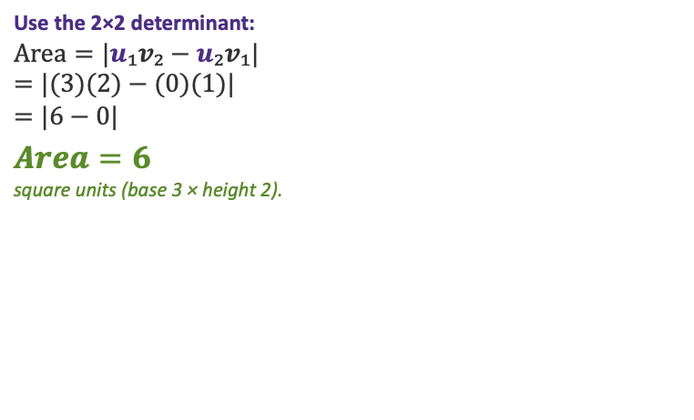


Exercise — Area of the parallelogram spanned by $u, v$
The parallelogram spanned by u and v is shaded on the grid. Find its area.
$$u=(3, 0) v=(1, 2)$$
$$Find the area of the shaded parallelogram.$$
Parallelogram spanned by u, v
Solution hidden
Compute the area yourself, then remove this cover to check.
6
y
Use the 2×2 determinant:
$$Area=|u₁v₂−u₂v₁|$$
$$=|(3)(2)−(0)(1)|$$
$$=|6−0|$$
$$Area=6$$
square units (base 3 × height 2).
5
4
3
2
$$v$$
1
x
0
1
2
3
4
5
6
$$u$$
In 2D the area equals the absolute value of the 2×2 determinant: $Area=|u₁v₂−u₂v₁|$

Slide 105
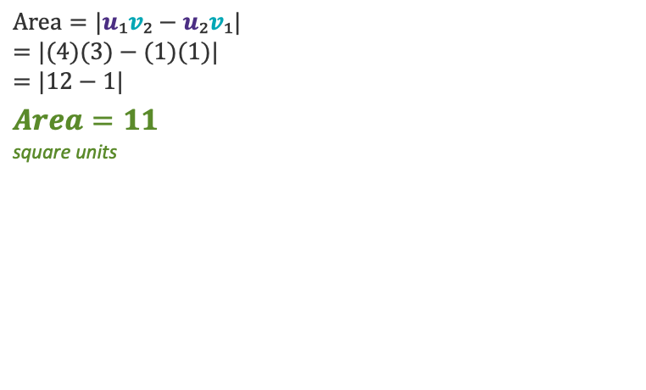

Exercise — Area of the parallelogram spanned by $u, v$
The parallelogram spanned by u and v is shaded on the grid. Find its area.
$$u=(4, 1) v=(1, 3)$$
$$Find the area of the shaded parallelogram.$$
Parallelogram spanned by u, v
Solution hidden
Compute the area yourself, then remove this cover to check.
6
y
$$Area=|u₁v₂−u₂v₁|$$
$$=|(4)(3)−(1)(1)|$$
$$=|12−1|$$
$$Area=11$$
square units
5
4
$$v$$
3
2
1
$$u$$
x
0
1
2
3
4
5
6
In 2D the area equals the absolute value of the 2×2 determinant: $Area=|u₁v₂−u₂v₁|$

Slide 106
DATA AS VECTORS
Matrix Definition
Reading a data matrix as a collection of vectors

Slide 107
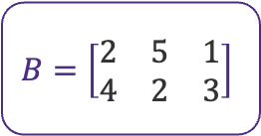
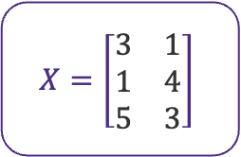
Reading a Matrix as Vectors
A data matrix has two readings: rows are individuals, columns are features.
X · 3 individuals × 2 features
B · columns of a 2×3 matrix
Rows = individual vectors (feature space)
Columns = feature vectors (observation space)
6
y
6
$$X=\left[\begin{matrix}3 & 1 \\ 1 & 4 \\ 5 & 3\end{matrix}\right]$$
$$B=\left[\begin{matrix}2 & 5 & 1 \\ 4 & 2 & 3\end{matrix}\right]$$
5
5
r₂=(1,4)
c₁=(2,4)
4
4
r₃=(5,3)
3
3
c₃=(1,3)
c₂=(5,2)
2
2
r₁=(3,1)
1
1
x
0
1
2
3
4
5
6
0
1
2
3
4
5
6
Same numbers, two views — rows describe individuals, columns describe features.

Slide 108
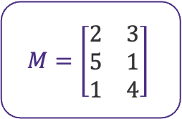
Exercise 1 — Plot the Row Vectors
Each row of the matrix is an individual vector in 2-D. Draw each as an arrow from the origin.
M · rows = r₁, r₂, r₃
Plot r₁, r₂, r₃ on the grid, then reveal the solution.
Your plot
Solution — row vectors plotted
y
Solution hidden
Plot the three row vectors, then remove this cover to check.
6
$$M=\left[\begin{matrix}2 & 3 \\ 5 & 1 \\ 1 & 4\end{matrix}\right]$$
6
5
5
r₃=(1,4)
4
4
r₁=(2,3)
3
3
2
2
r₂=(5,1)
1
1
x
0
1
2
3
4
5
6
0
1
2
3
4
5
6
Each row of the data matrix is one individual, plotted as a vector in feature space.

Slide 109
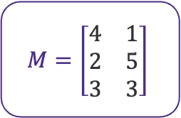
Exercise 2 — Plot the Row Vectors
Each row of the matrix is an individual vector in 2-D. Draw each as an arrow from the origin.
M · rows = r₁, r₂, r₃
Plot r₁, r₂, r₃ on the grid, then reveal the solution.
Your plot
Solution — row vectors plotted
y
Solution hidden
Plot the three row vectors, then remove this cover to check.
6
$$M=\left[\begin{matrix}4 & 1 \\ 2 & 5 \\ 3 & 3\end{matrix}\right]$$
6
r₂=(2,5)
5
5
4
4
r₃=(3,3)
3
3
2
2
r₁=(4,1)
1
1
x
0
1
2
3
4
5
6
0
1
2
3
4
5
6
Each row of the data matrix is one individual, plotted as a vector in feature space.

Slide 110
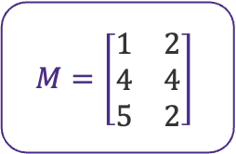
Exercise 3 — Plot the Row Vectors
Each row of the matrix is an individual vector in 2-D. Draw each as an arrow from the origin.
M · rows = r₁, r₂, r₃
Plot r₁, r₂, r₃ on the grid, then reveal the solution.
Your plot
Solution — row vectors plotted
y
Solution hidden
Plot the three row vectors, then remove this cover to check.
6
$$M=\left[\begin{matrix}1 & 2 \\ 4 & 4 \\ 5 & 2\end{matrix}\right]$$
6
5
5
r₂=(4,4)
4
4
3
3
r₁=(1,2)
r₃=(5,2)
2
2
1
1
x
0
1
2
3
4
5
6
0
1
2
3
4
5
6
Each row of the data matrix is one individual, plotted as a vector in feature space.

Slide 111
Matrix–Vector Multiplication
Apply a linear transformation to a vector
Definition
(A·x)ᵢ = Σⱼ Aᵢⱼ · xⱼ Aₘₓₙ · xₙₓ₁ = yₘₓ₁
Each output entry is the dot product of a row of A with x. Inner dimensions must match.
What it does
Geometric view
Why it matters
Combines rows of A with x via dot product.
Result y has one entry per row of A.
Dimensions:
(m×n)·(n×1) = (m×1)
A is a linear map ℝⁿ → ℝᵐ.
Multiplying by A:
• rotates
• scales
• shears
• projects
the vector x.
Heart of ML:
• Neural layer: y = Wx + b
• Linear regression: ŷ = Xβ
• PCA projection: z = Wx
• Coordinate transform
Two equivalent views: Σ-of-dot-products (row view) ≡ Σ-of-columns-scaled-by-xⱼ (column view)
A·x = the linear transformation A applied to vector x

Slide 112




Multiplying by A Transforms x
The same vector x under four different matrices A — rotate, scale, shear, project.
Rotate
Scale
$$A =\left[\begin{matrix}0 & −1 \\ 1 & 0\end{matrix}\right]$$
Ax
$$A =\left[\begin{matrix}1.5 & 0 \\ 0 & 1.5\end{matrix}\right]$$
Ax
x
x
x = (2, 1) Ax = (−1, 2)
x = (2, 1) Ax = (3, 1.5)
Spins x around the origin; its length is unchanged.
Stretches x by 1.5×; its direction is unchanged.
Shear
Project
$$A =\left[\begin{matrix}1 & 1.5 \\ 0 & 1\end{matrix}\right]$$
$$A =\left[\begin{matrix}1 & 0 \\ 0 & 0\end{matrix}\right]$$
x
Ax
x
Ax
x = (2, 1) Ax = (3.5, 1)
x = (2, 1) Ax = (2, 0)
Slides x sideways in proportion to its height.
Flattens x onto the x-axis; one dimension is lost.
A matrix is a geometric action: each A reshapes space — turning, stretching, slanting, or flattening x.

Slide 113
Example 1 — Matrix–Vector Multiplication
2×3 matrix times a 3-vector
Question
1
1
2
2
3
3
Compute A·x where A =
Compute A·x where A =
x = (1, 0, −1)
x = (1, 0, −1)
4
4
5
5
6
6
Solution (hidden until reveal)
Row 1 · x: (1)(1) + (2)(0) + (3)(-1) = 1 + 0 - 3 = -2
Row 2 · x: (4)(1) + (5)(0) + (6)(-1) = 4 + 0 - 6 = -2
Stack row results into output vector y:
A · x = (-2, -2)ᵀ
Answer: A·x = (-2, -2)ᵀ
Each output entry = dot product of one matrix row with x

Slide 114
Example 2 — 90° Rotation Matrix
Geometric meaning: rotate a 2D vector by 90° counter-clockwise
Question
0
−1
Compute R·x where R =
x = (3, 4)
1
0
Solution (hidden until reveal)
Row 1 · x: (0)(3) + (-1)(4) = -4
Row 2 · x: (1)(3) + (0)(4) = 3
Geometric check: (3,4) has length 5; rotated 90° CCW → (-4, 3) also length 5. ✓
Answer: R·x = (-4, 3)ᵀ — the original vector rotated 90° counter-clockwise
Length preserved (rotation matrices preserve magnitude — they're orthogonal).
Matrices encode geometric transformations: rotation, scaling, reflection, shear

Slide 115
Example 3 — A Neural Network Layer
Linear layer: y = W·x (3 inputs → 2 outputs)
Question
0.5
−0.2
0.3
Compute y = W·x where W =
−0.1
0.4
0.6
x = (2, 1, 4)
Solution (hidden until reveal)
y₁ = (0.5)(2) + (-0.2)(1) + (0.3)(4) = 1.0 - 0.2 + 1.2 = 2.0
y₂ = (-0.1)(2) + (0.4)(1) + (0.6)(4) = -0.2 + 0.4 + 2.4 = 2.6
Stack outputs: y = (2.0, 2.6)ᵀ
Answer: y = (2.0, 2.6)ᵀ
This is exactly one forward pass through a fully-connected layer (without bias or activation).
Every neural network is a stack of matrix–vector multiplications + nonlinearities

Slide 116

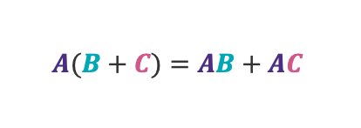
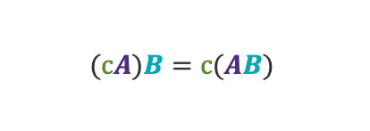




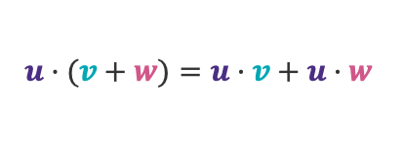
Properties of Vector & Matrix Multiplication
The algebra rules that do — and don't — carry over from ordinary numbers.
Associative
Distributive
Not commutative
Identity
$$(AB)C=A(BC)$$
$$A(B+C)=AB+AC$$
$$AB≠BA$$
$$AI=IA=A$$
Regroup freely
Multiply over sums
Order matters!
I leaves A unchanged
Transpose of product
Scalar factor
Dot — commutative
Dot — distributive
$${(AB)}^{T}=B^{T}A^{T}$$
$$(cA)B=c(AB)$$
$$u·v=v·u$$
$$u·(v+w)=u·v+u·w$$
Order reverses
Scalars slide out
Dot product commutes
Spreads over sums
Multiplication is associative and distributive, but order matters: matrix products do not commute.

Slide 117
Matrix–Matrix Multiplication
Composing two linear maps into one
Definition
(A · B)ᵢⱼ = Σₖ Aᵢₖ · Bₖⱼ A is m×n, B is n×p, result is m×p
Inner dimensions must match. Each entry of A·B is a dot product of a row of A with a column of B.
What it does
Geometry
Why it matters
Multiplies each row of A by each column of B.
• Row i of A · Col j of B → entry (i,j)
• Shape rule: (m×n)·(n×p)=(m×p)
• NOT commutative: A·B ≠ B·A in general
Composition of linear maps.
If B maps ℝᵖ → ℝⁿ
and A maps ℝⁿ → ℝᵐ,
then A·B maps ℝᵖ → ℝᵐ.
Applying B then A = applying A·B.
Powers most of ML:
• Stacked layers: W₂·W₁·x
• Covariance: XᵀX
• Attention: QKᵀ
• Solving linear systems
• Change of basis
Shape rule: (m×n) · (n×p) = (m×p) — inner dims must match
Matrix multiplication = stacking linear maps, one after the other

Slide 118
Example 1 — Matrix × Matrix
2×2 times 2×2 — the basic case
Question
$$Compute A·B where A = \left[\begin{matrix}1 & 2 \\ 3 & 4\end{matrix}\right] and B = \left[\begin{matrix}5 & 6 \\ 7 & 8\end{matrix}\right]$$
Result shape should be 2×2.
Solution (hidden until reveal)
$${(A·B)}_{11} = 1·5 + 2·7 = 5 + 14 = 19$$
$${(A·B)}_{12} = 1·6 + 2·8 = 6 + 16 = 22$$
$${(A·B)}_{21} = 3·5 + 4·7 = 15 + 28 = 43$$
$${(A·B)}_{22} = 3·6 + 4·8 = 18 + 32 = 50$$
$$Answer: A·B = \left[\begin{matrix}19 & 22 \\ 43 & 50\end{matrix}\right]$$
Every entry of A·B is a dot product of one row of A with one column of B

Slide 119
Example 2 — Non-commutativity
Show that A · B ≠ B · A in general
Question
$$Given A = \left[\begin{matrix}0 & 1 \\ 1 & 0\end{matrix}\right] (a swap matrix) and B = \left[\begin{matrix}1 & 2 \\ 3 & 4\end{matrix}\right],$$
compute both A · B and B · A. Are they equal?
Solution (hidden until reveal)
A · B (left-multiplying by swap → swap the ROWS of B):
$$A·B = \left[\begin{matrix}3 & 4 \\ 1 & 2\end{matrix}\right]$$
B · A (right-multiplying by swap → swap the COLUMNS of B):
$$B·A = \left[\begin{matrix}2 & 1 \\ 4 & 3\end{matrix}\right]$$
Conclusion: A · B ≠ B · A — matrix multiplication is NOT commutative.
Order matters: left vs right multiplication produce different results

Slide 120
Example 3 — Composing Two Linear Maps
Stacking transformations in a neural network
Question
$$Layer 1: W_{1} = \left[\begin{matrix}1 & 0 \\ 0 & 2\end{matrix}\right] Layer 2: W_{2} = \left[\begin{matrix}1 & 1 \\ −1 & 1\end{matrix}\right]$$
W₁ scales y by 2; W₂ rotates and scales.
Find the single matrix W = W₂ · W₁ that performs both layers in one step.
Solution (hidden until reveal)
W = W₂·W₁ → entry (i,j) = row i of W₂ · col j of W₁
$${(W)}_{11} = 1·1 + 1·0 = 1 {(W)}_{12} = 1·0 + 1·2 = 2$$
$${(W)}_{21} = −1·1 + 1·0 = −1 {(W)}_{22} = −1·0 + 1·2 = 2$$
One composed matrix replaces both layers — same result, faster compute.
$$Answer: W = W_{2}·W_{1} = \left[\begin{matrix}1 & 2 \\ −1 & 2\end{matrix}\right]$$
Matrix multiplication = pre-computing a stack of linear layers as one map

Slide 121
Determinant of a Matrix
A single number that captures how a matrix scales space and whether it's invertible
Definition (2×2 case)
det(A) = |A| = a·d − b·c for A = [[a,b],[c,d]]
For 3×3 and beyond: cofactor expansion, or det(A) = product of eigenvalues. Defined only for square matrices.
What it measures
Geometry
Why it matters
Signed scaling factor of the transformation A.
|det(A)| = how much A stretches
or shrinks area / volume.
Sign tells if orientation flips.
det(A) = area of the parallelogram
spanned by the columns of A.
• det = 0 → flattened to a line
• det > 0 → preserves orientation
• det < 0 → flips orientation
• Invertible iff det(A) ≠ 0
• Solves Ax=b via Cramer's rule
• Change-of-variables in integration
• Volume in geometry & physics
• Stability checks in dynamics
Key facts: det(I) = 1 · det(A·B) = det(A)·det(B) · det(A) = 0 ⇔ A is singular
The determinant compresses an entire transformation into one number — area, sign, invertibility

Slide 122


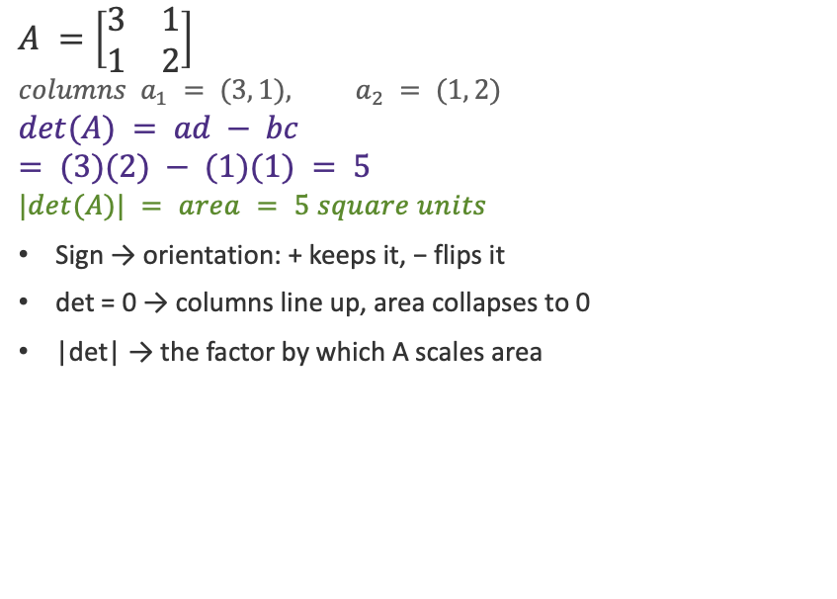

The Determinant Is a Signed Area
For a 2×2 matrix, det(A) is the area of the parallelogram spanned by its columns.
Columns of A span a parallelogram
Compute and interpret det(A)
Parallelogram from a₁=(3,1), a₂=(1,2)
$$A =\left[\begin{matrix}3 & 1 \\ 1 & 2\end{matrix}\right]$$
$$columns a_{1} = (3, 1), a_{2} = (1, 2)$$
$$det(A) = ad − bc$$
$$= (3)(2) − (1)(1) = 5$$
$$|det(A)| = area = 5 square units$$
Sign → orientation: + keeps it, − flips it
det = 0 → columns line up, area collapses to 0
|det| → the factor by which A scales area
6
y
5
4
3
$$a_{2} = (1, 2)$$
2
$$Area = 5$$
1
$$a_{1} = (3, 1)$$
x
0
1
2
3
4
5
6
det(A) measures how A scales area — and its sign tells you whether orientation flips.

Slide 123
Properties of the Determinant
Key rules that make determinants easy to compute and reason about.
det(I) = 1
det(AB) = det(A) · det(B)
The identity transformation leaves every area unchanged.
The determinant of a product is the product of the determinants.
det(Aᵀ) = det(A)
det(A⁻¹) = 1 / det(A)
A matrix and its transpose have the same determinant.
Defined only when det(A) ≠ 0 — otherwise no inverse exists.
det(A) = 0 ⇔ A is singular
det(kA) = kⁿ · det(A)
Zero determinant means the columns are dependent and A has no inverse.
Scaling an n×n matrix scales area by kⁿ (k² in 2D).
These properties turn the determinant into a fast test for invertibility and a tracker of area.

Slide 124
Example 1 — Determinant of a 2×2
Direct application of det = ad − bc
Question
Compute det(A) where A = [[3, 2], [1, 4]]
Solution (hidden until reveal)
Step 1. Identify entries: a = 3, b = 2, c = 1, d = 4.
Step 2. Apply the formula: det(A) = a·d − b·c = (3)(4) − (2)(1)
Step 3. Compute: det(A) = 12 − 2 = 10.
Interpretation: |det| = 10 → A stretches area by factor 10; det > 0 → preserves orientation.
Answer: det(A) = 10
For 2×2 matrices, det = ad − bc — fast, exact, and tells you the area scale factor

Slide 125
Example 2 — Singular Matrix (det = 0)
When the determinant vanishes, the matrix collapses dimensions
Question
Compute det(B) where B = [[2, 6], [1, 3]]. Is B invertible?
Solution (hidden until reveal)
Step 1. Entries: a = 2, b = 6, c = 1, d = 3.
Step 2. Apply formula: det(B) = (2)(3) − (6)(1) = 6 − 6 = 0.
Step 3. Notice: row 2 = ½ · row 1 (linearly dependent rows).
Conclusion: det(B) = 0 → B is singular → B has no inverse → Bx = b has 0 or ∞ solutions.
Answer: det(B) = 0; B is NOT invertible.
Linearly dependent rows ⇒ det = 0 ⇒ matrix collapses space ⇒ no inverse exists

Slide 126
Example 3 — Determinant of a 3×3 (Cofactor)
Cofactor expansion along the first row
Question
Compute det(C) where C = [[1, 2, 3], [0, 4, 5], [1, 0, 6]].
Solution (hidden until reveal)
Step 1. Expand along row 1: det(C) = 1·M₁₁ − 2·M₁₂ + 3·M₁₃ (signs +, −, +)
Step 2. Minors: M₁₁=|4 5; 0 6| = 24, M₁₂=|0 5; 1 6| = −5, M₁₃=|0 4; 1 0| = −4
Step 3. Combine: det(C) = 1·(24) − 2·(−5) + 3·(−4)
Step 4. Compute: det(C) = 24 + 10 − 12 = 22.
Answer: det(C) = 22 (non-zero → C is invertible)
Cofactor expansion reduces an n×n determinant to a sum of (n−1)×(n−1) determinants

Slide 127
Inverse of a Matrix
The matrix that undoes A — the linear-algebra equivalent of dividing
Definition
A⁻¹ is the unique matrix such that A · A⁻¹ = A⁻¹ · A = I
Exists only if A is square AND det(A) ≠ 0. For 2×2: A⁻¹ = (1/det A)·[[d,-b],[-c,a]]
What it does
Geometry
Why it matters
Reverses the transformation A.
If y = A·x, then x = A⁻¹·y.
It's the closest matrix analog
of scalar reciprocal 1/a.
If A stretches by factor d,
A⁻¹ shrinks by factor 1/d.
If A rotates by θ,
A⁻¹ rotates by −θ.
Undoes scale, shear, rotation.
• Solves Ax = b: x = A⁻¹·b
• Closed-form least squares:
β̂ = (XᵀX)⁻¹Xᵀy
• Change of basis
• Covariance whitening, Mahalanobis
• Kalman filter update step
A⁻¹ undoes A — it exists when det(A) ≠ 0 and is the gateway to solving linear systems

Slide 128
The Inverse Undoes the Transformation
A⁻¹ applies the opposite action: solid = Ax, dashed = A⁻¹x, both from the same x.
Scale
Rotate
Shear
$$A = \left[\begin{matrix}2 & 0 \\ 0 & 2\end{matrix}\right]$$
$$A = \left[\begin{matrix}0 & −1 \\ 1 & 0\end{matrix}\right]$$
$$A = \left[\begin{matrix}1 & 1 \\ 0 & 1\end{matrix}\right]$$
$$A^{−1} = \left[\begin{matrix}½ & 0 \\ 0 & ½\end{matrix}\right]$$
$$A^{−1} = \left[\begin{matrix}0 & 1 \\ −1 & 0\end{matrix}\right]$$
$$A^{−1} = \left[\begin{matrix}1 & −1 \\ 0 & 1\end{matrix}\right]$$
Ax
Ax
A⁻¹x
Ax
A⁻¹x
x
x
x
A⁻¹x
Stretch by 2 → inverse shrinks by ½.
Rotate by +90° → inverse rotates by −90°.
Shear by +1 → inverse shears by −1.
Scale by d, rotate by θ, or shear by k — then A⁻¹ applies 1/d, −θ or −k, returning every vector to its start.

Slide 129
Example 1 — 2×2 Inverse
Standard formula on a clean 2×2
Question
$$Find A^{−1} where A = \left[\begin{matrix}4 & 3 \\ 2 & 1\end{matrix}\right]$$
$$Verify A · A^{−1} = I$$
Solution (hidden until reveal)
$$Step 1. det(A) = 4·1 − 3·2 = −2 (nonzero → invertible)$$
$$Step 2. Swap diagonal, negate off−diagonal: \left[\begin{matrix}1 & −3 \\ −2 & 4\end{matrix}\right]$$
$$Step 3. Multiply by 1/det(A) = −½ : A^{−1} = \left[\begin{matrix}−½ & 3/2 \\ 1 & −2\end{matrix}\right]$$
$$Verify: A · A^{−1} = \left[\begin{matrix}1 & 0 \\ 0 & 1\end{matrix}\right] = I ✓$$
$$Answer: A^{−1} = \left[\begin{matrix}−½ & 3/2 \\ 1 & −2\end{matrix}\right]$$
2×2 inverse = swap diagonal, negate off-diagonal, divide by det

Slide 130
Example 2 — When Inverse Does NOT Exist
Recognizing a singular matrix
Question
$$Does the inverse of B = \left[\begin{matrix}2 & 4 \\ 3 & 6\end{matrix}\right] exist?$$
$$If yes, compute it; if no, explain why.$$
Solution (hidden until reveal)
$$Step 1. Compute the determinant: det(B) = 2·6 − 4·3 = 12 − 12 = 0$$
$$Step 2. det(B) = 0 → B is SINGULAR (not invertible).$$
Why: row 2 = 1.5 × row 1 → the rows are linearly dependent.
Geometrically: B collapses ℝ² onto a single line, so no transformation undoes that collapse.
$$Answer: B^{−1} does NOT exist — B is singular (det = 0).$$
det(A) = 0 ⇔ A is singular ⇔ A⁻¹ does not exist

Slide 131
Example 3 — Solve a Linear System Using A⁻¹
From Ax = b to x = A⁻¹b
Question
$$Solve A·x = b for x, given$$
$$A = \left[\begin{matrix}1 & 2 \\ 3 & 5\end{matrix}\right] and b = (4, 13)$$
Solution (hidden until reveal)
$$Step 1. det(A) = 1·5 − 2·3 = −1 (nonzero → A is invertible)$$
$$Step 2. A^{−1} = (1/−1)· \left[\begin{matrix}5 & −2 \\ −3 & 1\end{matrix}\right] = \left[\begin{matrix}−5 & 2 \\ 3 & −1\end{matrix}\right]$$
$$Step 3. x = A^{−1}·b = \left[\begin{matrix}−5 & 2 \\ 3 & −1\end{matrix}\right]·(4, 13) = (−5·4 + 2·13, 3·4 − 1·13)$$
$$= (−20 + 26, 12 − 13) = (6, −1)$$
$$Verify: A·x = (1·6 + 2·(−1), 3·6 + 5·(−1)) = (4, 13) = b ✓$$
$$Answer: x = (6, −1)$$
When A is invertible, every system Ax = b has the unique solution x = A⁻¹b

Slide 132
LARGER MATRICES
Determinant
Cofactor expansion for the determinant, and the adjugate method for the inverse.

Slide 133

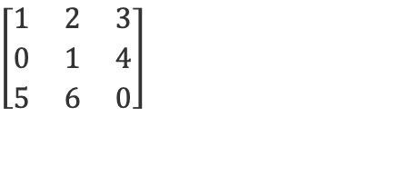




Determinant of a 3×3 by Cofactor Expansion
Expand along a row: multiply each entry by its signed 2×2 minor, then add.
Step 1 — Set up the expansion
Step 2 — Minors, then combine
$$\left[\begin{matrix}1 & 2 & 3 \\ 0 & 1 & 4 \\ 5 & 6 & 0\end{matrix}\right]$$
A =
$$M_{11} = det\left[\begin{matrix}1 & 4 \\ 6 & 0\end{matrix}\right] = (1)(0) − (4)(6) = −24$$
$$M_{12} = det\left[\begin{matrix}0 & 4 \\ 5 & 0\end{matrix}\right] = (0)(0) − (4)(5) = −20$$
Signs along row 1: + − +
$$M_{13} = det\left[\begin{matrix}0 & 1 \\ 5 & 6\end{matrix}\right] = (0)(6) − (1)(5) = −5$$
$$det(A) = +a_{11}·M_{11} − a_{12}·M_{12} + a_{13}·M_{13}$$
$$det(A) = (1)(−24) − (2)(−20) + (3)(−5)$$
with row 1 = (1, 2, 3)
$$= −24 + 40 − 15$$
$$det(A) = 1$$
$$det(A) = (1)M_{11} − (2)M_{12} + (3)M_{13}$$
Cofactor expansion reduces an n×n determinant to smaller ones — three 2×2 minors give det(A) = 1.

Slide 134

Cofactor C₁₁ · determinant (expand along row 1)
Multiply each row-1 entry by its signed minor.
Delete row 1 and column 1:
Compute the cofactor
What remains is the 2×2 minor M₁₁:
1
4
1
2
3
6
0
A =
0
1
4
$$M_{11} = (1)(0) − (4)(6) = −24$$
5
6
0
$$sign {(−1)}^{(1+1)} = +$$
$$C_{11} = (+)(−24) = −24$$
pivot a₁₁
minor M₁₁ cells
$$term a_{11}·C_{11} = (1)(−24) = −24$$
det(A) = a₁₁C₁₁ + a₁₂C₁₂ + a₁₃C₁₃ — the three row-1 cofactors.

Slide 135

Cofactor C₁₂ · determinant (expand along row 1)
Multiply each row-1 entry by its signed minor.
Delete row 1 and column 2:
Compute the cofactor
What remains is the 2×2 minor M₁₂:
0
4
1
2
3
5
0
A =
0
1
4
$$M_{12} = (0)(0) − (4)(5) = −20$$
5
6
0
$$sign {(−1)}^{(1+2)} = −$$
$$C_{12} = (−)(−20) = 20$$
pivot a₁₂
minor M₁₂ cells
$$term a_{12}·C_{12} = (2)(20) = 40$$
det(A) = a₁₁C₁₁ + a₁₂C₁₂ + a₁₃C₁₃ — the three row-1 cofactors.

Slide 136

Cofactor C₁₃ · determinant (expand along row 1)
Multiply each row-1 entry by its signed minor.
Delete row 1 and column 3:
Compute the cofactor
What remains is the 2×2 minor M₁₃:
0
1
1
2
3
5
6
A =
0
1
4
$$M_{13} = (0)(6) − (1)(5) = −5$$
5
6
0
$$sign {(−1)}^{(1+3)} = +$$
$$C_{13} = (+)(−5) = −5$$
pivot a₁₃
minor M₁₃ cells
$$term a_{13}·C_{13} = (3)(−5) = −15$$
det(A) = a₁₁C₁₁ + a₁₂C₁₂ + a₁₃C₁₃ — the three row-1 cofactors.

Slide 137

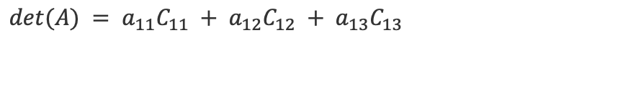
Determinant — Combine the Three Cofactors
Add the row-1 terms: a₁₁C₁₁ + a₁₂C₁₂ + a₁₃C₁₃.
Expand along row 1 (highlighted):
Plug in the cofactors
$$a_{11}·C_{11} = (1)(−24) = −24$$
1
2
3
$$a_{12}·C_{12} = (2)(+20) = +40$$
A =
0
1
4
$$a_{13}·C_{13} = (3)(−5) = −15$$
5
6
0
$$det(A) = −24 + 40 − 15$$
$$det(A) = 1$$
$$det(A) = a_{11}C_{11} + a_{12}C_{12} + a_{13}C_{13}$$
Expanding along any row or column gives the same value — here det(A) = 1.

Slide 138
LARGER MATRICES
Inverse
Cofactor expansion for the determinant, and the adjugate method for the inverse.

Slide 139
The Transpose Aᵀ
Reflect a matrix across its main diagonal — rows become columns.
Matrix A — each row colored
Transpose Aᵀ — those rows are now columns
1
2
3
1
0
5
A =
0
1
4
Aᵀ =
2
1
6
5
6
0
3
4
0
Reflect across the diagonal (↖↘): the entry in row i, column j moves to row j, column i.
row i of A → column i of Aᵀ ${(A^{T})}_{ij} = A_{ji}$
Transposing swaps rows and columns: (Aᵀ)ᵢⱼ = Aⱼᵢ. The diagonal is unchanged and (Aᵀ)ᵀ = A.

Slide 140
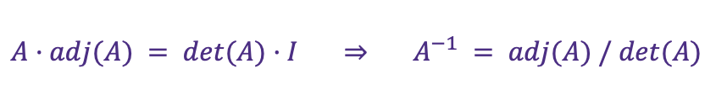
The Adjugate adj(A)
The adjugate is the transpose of the cofactor matrix.
Step 1 — cofactor matrix C
Step 2 — transpose to get adj(A)
Replace each entry by its signed minor $C_{ij} = {(−1)}^{(i+j)} M_{ij}$ :
$adj(A) = C^{T}$ : row i of C becomes column i.
−24
20
−5
−24
18
5
C =
18
−15
4
adj(A) =
20
−15
−4
5
−4
1
−5
4
1
$$A·adj(A) = det(A)·I ⇒ A^{−1} = adj(A) / det(A)$$
adj(A) collects every signed cofactor and transposes them; dividing by det(A) gives the inverse.

Slide 141
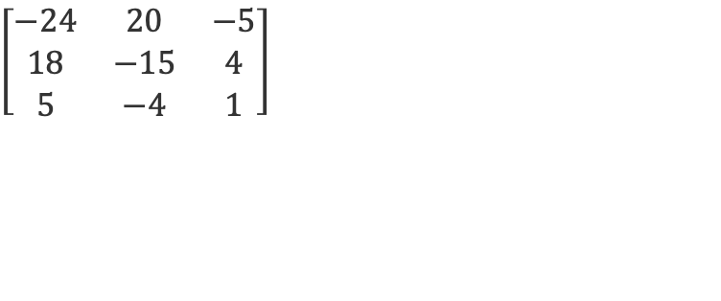
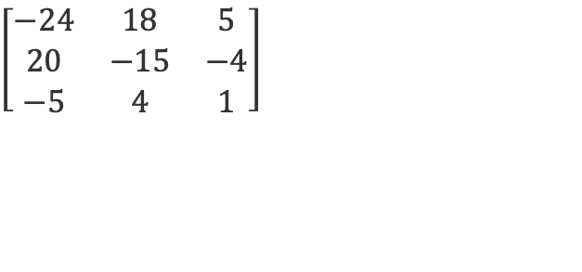
Inverse of a 3×3 with the Adjugate
A⁻¹ = (1/det A)·adj(A), where adj(A) is the transpose of the cofactor matrix.
Step 1 — Determinant & cofactors
Step 2 — Transpose, then divide
$$A^{−1} = adj(A) / det(A)$$
Transpose C to get adj(A); then divide every entry by det(A) = 1.
det(A) = 1 (from the cofactor expansion)
$$A^{−1} = adj(A) = C^{T}$$
Cofactor matrix C (signed minors of A):
$$\left[\begin{matrix}−24 & 20 & −5 \\ 18 & −15 & 4 \\ 5 & −4 & 1\end{matrix}\right]$$
$$\left[\begin{matrix}−24 & 18 & 5 \\ 20 & −15 & −4 \\ −5 & 4 & 1\end{matrix}\right]$$
A⁻¹ =
Check: A · A⁻¹ = I
Cofactors → transpose → divide by det. With det(A) = 1, A⁻¹ comes out in whole numbers.

Slide 142
Cofactor C₁₁ · adjugate
Each entry a₁₁ has a signed cofactor; the nine of them form matrix C.
Delete row 1 and column 1:
Compute the cofactor
What remains is the 2×2 minor M₁₁:
1
4
1
2
3
6
0
A =
0
1
4
$$M_{11} = (1)(0) − (4)(6) = −24$$
5
6
0
$$sign {(−1)}^{(1+1)} = +$$
$$C_{11} = (+)(−24) = −24$$
pivot a₁₁
minor M₁₁ cells
→ place −24 at position (1, 1) of cofactor matrix C
Collect all nine cofactors into C, then transpose to form adj(A).

Slide 143
Cofactor C₁₂ · adjugate
Each entry a₁₂ has a signed cofactor; the nine of them form matrix C.
Delete row 1 and column 2:
Compute the cofactor
What remains is the 2×2 minor M₁₂:
0
4
1
2
3
5
0
A =
0
1
4
$$M_{12} = (0)(0) − (4)(5) = −20$$
5
6
0
$$sign {(−1)}^{(1+2)} = −$$
$$C_{12} = (−)(−20) = 20$$
pivot a₁₂
minor M₁₂ cells
→ place 20 at position (1, 2) of cofactor matrix C
Collect all nine cofactors into C, then transpose to form adj(A).

Slide 144
Cofactor C₁₃ · adjugate
Each entry a₁₃ has a signed cofactor; the nine of them form matrix C.
Delete row 1 and column 3:
Compute the cofactor
What remains is the 2×2 minor M₁₃:
0
1
1
2
3
5
6
A =
0
1
4
$$M_{13} = (0)(6) − (1)(5) = −5$$
5
6
0
$$sign {(−1)}^{(1+3)} = +$$
$$C_{13} = (+)(−5) = −5$$
pivot a₁₃
minor M₁₃ cells
→ place −5 at position (1, 3) of cofactor matrix C
Collect all nine cofactors into C, then transpose to form adj(A).

Slide 145
Cofactor C₂₁ · adjugate
Each entry a₂₁ has a signed cofactor; the nine of them form matrix C.
Delete row 2 and column 1:
Compute the cofactor
What remains is the 2×2 minor M₂₁:
2
3
1
2
3
6
0
A =
0
1
4
$$M_{21} = (2)(0) − (3)(6) = −18$$
5
6
0
$$sign {(−1)}^{(2+1)} = −$$
$$C_{21} = (−)(−18) = 18$$
pivot a₂₁
minor M₂₁ cells
→ place 18 at position (2, 1) of cofactor matrix C
Collect all nine cofactors into C, then transpose to form adj(A).

Slide 146
Cofactor C₂₂ · adjugate
Each entry a₂₂ has a signed cofactor; the nine of them form matrix C.
Delete row 2 and column 2:
Compute the cofactor
What remains is the 2×2 minor M₂₂:
1
3
1
2
3
5
0
A =
0
1
4
$$M_{22} = (1)(0) − (3)(5) = −15$$
5
6
0
$$sign {(−1)}^{(2+2)} = +$$
$$C_{22} = (+)(−15) = −15$$
pivot a₂₂
minor M₂₂ cells
→ place −15 at position (2, 2) of cofactor matrix C
Collect all nine cofactors into C, then transpose to form adj(A).

Slide 147
Cofactor C₂₃ · adjugate
Each entry a₂₃ has a signed cofactor; the nine of them form matrix C.
Delete row 2 and column 3:
Compute the cofactor
What remains is the 2×2 minor M₂₃:
1
2
1
2
3
5
6
A =
0
1
4
$$M_{23} = (1)(6) − (2)(5) = −4$$
5
6
0
$$sign {(−1)}^{(2+3)} = −$$
$$C_{23} = (−)(−4) = 4$$
pivot a₂₃
minor M₂₃ cells
→ place 4 at position (2, 3) of cofactor matrix C
Collect all nine cofactors into C, then transpose to form adj(A).

Slide 148
Cofactor C₃₁ · adjugate
Each entry a₃₁ has a signed cofactor; the nine of them form matrix C.
Delete row 3 and column 1:
Compute the cofactor
What remains is the 2×2 minor M₃₁:
2
3
1
2
3
1
4
A =
0
1
4
$$M_{31} = (2)(4) − (3)(1) = 5$$
5
6
0
$$sign {(−1)}^{(3+1)} = +$$
$$C_{31} = (+)(5) = 5$$
pivot a₃₁
minor M₃₁ cells
→ place 5 at position (3, 1) of cofactor matrix C
Collect all nine cofactors into C, then transpose to form adj(A).

Slide 149
Cofactor C₃₂ · adjugate
Each entry a₃₂ has a signed cofactor; the nine of them form matrix C.
Delete row 3 and column 2:
Compute the cofactor
What remains is the 2×2 minor M₃₂:
1
3
1
2
3
0
4
A =
0
1
4
$$M_{32} = (1)(4) − (3)(0) = 4$$
5
6
0
$$sign {(−1)}^{(3+2)} = −$$
$$C_{32} = (−)(4) = −4$$
pivot a₃₂
minor M₃₂ cells
→ place −4 at position (3, 2) of cofactor matrix C
Collect all nine cofactors into C, then transpose to form adj(A).

Slide 150
Cofactor C₃₃ · adjugate
Each entry a₃₃ has a signed cofactor; the nine of them form matrix C.
Delete row 3 and column 3:
Compute the cofactor
What remains is the 2×2 minor M₃₃:
1
2
1
2
3
0
1
A =
0
1
4
$$M_{33} = (1)(1) − (2)(0) = 1$$
5
6
0
$$sign {(−1)}^{(3+3)} = +$$
$$C_{33} = (+)(1) = 1$$
pivot a₃₃
minor M₃₃ cells
→ place 1 at position (3, 3) of cofactor matrix C
Collect all nine cofactors into C, then transpose to form adj(A).

Slide 151
Assemble the Cofactor Matrix C
Collect the nine cofactors Cᵢⱼ into one matrix, following the +−+ sign pattern.
Sign pattern (−1)ⁱ⁺ʲ
Cofactor matrix C
+
−
+
−24
20
−5
−
+
−
C =
18
−15
4
+
−
+
5
−4
1
$$C_{ij} = {(−1)}^{i+j} · M_{ij}$$
Each cofactor = signed 2×2 minor (previous slides).
Negative entries shown in pink.
The nine cofactors form C — transpose it next to get the adjugate adj(A).

Slide 152
Transpose to Get the Adjugate
adj(A) = Cᵀ — row i of C becomes column i of adj(A).
Cofactor matrix C
adj(A) = Cᵀ
−24
20
−5
−24
18
5
18
−15
4
20
−15
−4
5
−4
1
−5
4
1
rows →
→ columns
Transposing swaps rows and columns; the result is the adjugate, adj(A) = Cᵀ.

Slide 153
Form the Inverse: A⁻¹ = adj(A) / det(A)
Divide every entry of adj(A) by det(A) = 1.
$$A^{−1} = adj(A) / det(A)$$
The inverse
A⁻¹ = adj(A) / det(A)
A⁻¹ =
−24
18
5
det(A) = 1 (from the cofactor expansion)
20
−15
−4
adj(A) = transpose of cofactor matrix C
Dividing by 1 changes nothing — so the inverse is exactly adj(A). Always finish by checking A·A⁻¹ = I.
−5
4
1
Check: A · A⁻¹ = I ✓
A⁻¹ = adj(A) / det(A); since det(A) = 1, the inverse equals the adjugate exactly.

Slide 154
d
GEOMETRY OF VECTORS
Distance
Dot product, norm, and cosine similarity — measuring vectors and the gaps between them.

Slide 155
Distance — a formal definition
From topology: a distance (or metric) is a function that measures how far apart two points are in a set
DEFINITION
A distance on a set X is a function d : X × X → ℝ
that assigns a non-negative real number d(x, y) to every pair of points x, y ∈ X.
The pair (X, d) is called a metric space.
1
Same set, two points
2
Output is a real number
3
Geometry, not just numbers
x and y belong to the SAME set X — apples-to-apples comparison.
d(x, y) ∈ ℝ — a single scalar that quantifies separation.
Distance turns a bare set into a geometric space — we can speak of 'near', 'far', and 'between'.
EXAMPLE
If X = ℝ² and x = (1, 2), y = (4, 6), then d(x, y) measures how far apart these two points are in the plane.
A distance is the rulebook that turns a bare collection of objects into a space we can measure

Slide 156
The Dot Product a · b
Pair up components and add — a single number measuring how much two vectors align.
Component form
6
$$a·b = a_{1}b_{1} + a_{2}b_{2}$$
5
$$= (4)(1) + (1)(3) = 7$$
4
Geometric form
b = (1,3)
$$a·b = ‖a‖‖b‖\text{cos }θ$$
3
2
• > 0 vectors point the same way
• = 0 vectors are perpendicular
• < 0 vectors point opposite ways
1
a = (4,1)
1
2
3
4
5
6
a·b pairs components and equals ‖a‖‖b‖cosθ — positive when aligned, zero when perpendicular.

Slide 157
The Norm ‖a‖
The length of a vector — its straight-line distance from the origin.
$$‖a‖ = \sqrt{{a_{1}}^{2} + {a_{2}}^{2}}$$
6
$$= \sqrt{4^{2} + 3^{2}} = \sqrt{25} = 5$$
5
$${‖a‖}^{2} = a·a$$
4
a = (4, 3)
‖a‖² = a · a (norm from the dot product)
3
2
‖a‖ = 5
3
• Distance from the origin to the tip.
• Always ≥ 0; zero only for the zero vector.
• ‖ka‖ = |k|·‖a‖ (scales with length).
1
0
1
2
3
4
5
6
The norm is a vector's length: ‖a‖ = √(a·a), the distance from the origin to its tip.

Slide 158
Cosine Similarity cos θ
How aligned two vectors are — independent of their length.
Angle θ between a and b
Measure direction, not size
6
$$\text{cos }θ = \frac{a·b}{‖a‖‖b‖}$$
5
$$= \frac{7}{\sqrt{17}·\sqrt{10}} ≈ 0.54$$
θ ≈ 58°
4
b
Scale-invariant: cos θ ignores vector length.
3
cos θ = +1 same direction
2
cos θ = 0 perpendicular (unrelated)
1
θ
a
cos θ = −1 opposite direction
0
1
2
3
4
5
6
Range: −1 ≤ cos θ ≤ +1
Cosine similarity reads the angle between vectors: +1 aligned, 0 perpendicular, −1 opposite.

Slide 159
Distance Between People
Each person is a point: x = Age, y = Income. Closer points mean more similar people.
Each person = a point (Age, Income)
6
Income ↑
Ann = (1, 2) Bob = (4, 5) Carol = (2, 4)
5
Euclidean distance between two people:
Bob
4
d ≈ 4.24
d(Ann, Bob) = √((4−1)² + (5−2)²)
Carol
3
= √(9 + 9) = √18 ≈ 4.24
2
Ann
Smaller distance → more similar people.
1
Tip: standardize Age and Income first, so the large income numbers don’t dominate the distance.
0
1
2
3
4
5
6
Age →
Treat each person as a vector — the distance between their points measures how similar they are.

Slide 160
Ann ↔ Bob: Distance Between Vectors
Each person is a vector from the origin; the gap between their tips is ‖Ann − Bob‖.
Subtract the two vectors
↑ Income
6
Ann = (1, 2) Bob = (4, 5)
5
Bob (4,5)
The distance is the length of the difference:
4
d ≈ 4.24
Bob − Ann = (3, 3)
3
d = ‖(3, 3)‖ = √(9 + 9) = √18 ≈ 4.24
2
Ann (1,2)
The dashed segment joining the two tips is the vector Bob − Ann. Its length is the distance between the two observations — the same as the distance between their vectors.
1
0
1
2
3
4
5
6
Age →
Distance between observations = ‖ a − b ‖ = distance between their vectors.

Slide 161
Ann ↔ Carol: Distance Between Vectors
Each person is a vector from the origin; the gap between their tips is ‖Ann − Carol‖.
Subtract the two vectors
↑ Income
6
Ann = (1, 2) Carol = (2, 4)
5
The distance is the length of the difference:
4
Carol (2,4)
Carol − Ann = (1, 2)
d ≈ 2.24
d = ‖(1, 2)‖ = √(1 + 4) = √5 ≈ 2.24
3
2
Ann (1,2)
The dashed segment joining the two tips is the vector Carol − Ann. Its length is the distance between the two observations — the same as the distance between their vectors.
1
0
1
2
3
4
5
6
Age →
Distance between observations = ‖ a − b ‖ = distance between their vectors.

Slide 162
Carol ↔ Bob: Distance Between Vectors
Each person is a vector from the origin; the gap between their tips is ‖Carol − Bob‖.
Subtract the two vectors
↑ Income
6
Carol = (2, 4) Bob = (4, 5)
5
d ≈ 2.24
Bob (4,5)
The distance is the length of the difference:
4
Carol (2,4)
Bob − Carol = (2, 1)
3
d = ‖(2, 1)‖ = √(4 + 1) = √5 ≈ 2.24
2
The dashed segment joining the two tips is the vector Bob − Carol. Its length is the distance between the two observations — the same as the distance between their vectors.
1
0
1
2
3
4
5
6
Age →
Distance between observations = ‖ a − b ‖ = distance between their vectors.

Slide 163
Properties: Dot Product · Norm · Cosine
Key rules behind the three vector measures.
Dot product a·b
Norm ‖a‖
Cosine similarity
a·b = b·a (commutative)
a·(b+c) = a·b + a·c
a·a = ‖a‖²
a·b = 0 ⇔ a ⊥ b
(k a)·b = k (a·b)
‖a‖ ≥ 0; = 0 only if a = 0
‖k a‖ = |k| · ‖a‖
‖a+b‖ ≤ ‖a‖ + ‖b‖ (triangle)
‖a‖ = √(a·a)
Distance from the origin
cos θ = (a·b) / (‖a‖‖b‖)
−1 ≤ cos θ ≤ 1
1 same dir · 0 ⊥ · −1 opposite
Scale-invariant (ignores length)
Direction, not magnitude
Dot product pairs components, norm gives length, cosine gives direction — together they measure vectors and distances.

Slide 164
Properties of a distance (metric axioms)
A function d : X × X → ℝ is a metric only if it satisfies these four axioms:
1. Non-negativity
2. Identity of indiscernibles
d(x, y) ≥ 0
d(x, y) = 0 ⟺ x = y
Distance is never negative. There is no such thing as 'negative far'.
Zero distance happens only when the two points are the same point.
3. Symmetry
4. Triangle inequality
d(x, y) = d(y, x)
d(x, z) ≤ d(x, y) + d(y, z)
Distance from x to y equals distance from y to x. Direction does not matter.
A detour through a third point is never shorter than going direct.
All four axioms together capture what we intuitively mean by "distance." Any function meeting them is a valid metric.

Slide 165
Vectorized distance — compute it the smart way
Once data lives in ℝⁿ, distance becomes a single algebraic formula — no loops needed.
Scalar approach — loop over coordinates
Vectorized approach — one expression
d = 0
for i in 1..n:
d += (uᵢ − vᵢ)²
d = √d
d(u, v) = ‖u − v‖
d = np.linalg.norm(u - v)
Works, but slow — n iterations per distance.
Subtract vectors, take the norm — done.
✗ O(n) loop in Python
✓ Runs in compiled BLAS — orders of magnitude faster
Concrete example — u = [1, 4, 2], v = [3, 0, 5]
u − v = [1−3, 4−0, 2−5] = [−2, 4, −3]
‖u − v‖ = √((−2)² + 4² + (−3)²) = √(4 + 16 + 9) = √29 ≈ 5.39
→ one line of code, three multiplications, one square root
Why vectorize?
• Hardware-friendly: SIMD + cache-aligned BLAS routines • Code clarity: formula ≈ math • Scales: same line works for n = 4 or n = 4,000,000
Think in vectors, not in loops — ‖u − v‖ is the lingua franca of distance in ML.

Slide 166
What is a norm? — measuring the size of a vector
A norm assigns a non-negative 'length' to every vector. Distance is then just the length of the difference.
Formal definition
A norm is a function ‖·‖ : V → ℝ that maps each vector v in a vector space V to a real number ‖v‖, satisfying three axioms (below).
The distance between two vectors u and v is then defined as d(u, v) = ‖u − v‖.
1
Non-negativity & definiteness
2
Absolute homogeneity
3
Triangle inequality
‖v‖ ≥ 0, and ‖v‖ = 0 ⟺ v = 0
‖α·v‖ = |α| · ‖v‖
‖u + v‖ ≤ ‖u‖ + ‖v‖
Only the zero vector has zero length. Everything else has positive size.
Scaling a vector by α stretches its length by |α|. Direction doesn't matter, only magnitude.
The sum of two vectors is never longer than the sum of their lengths — straight line wins.
Norm → distance:
Every norm induces a distance via d(u, v) = ‖u − v‖. All four metric properties (previous slides) follow automatically from the three norm axioms.
A norm is a 'ruler' for vectors. Pick a ruler → you've picked a notion of distance.

Slide 167
Computing the Euclidean norm — three worked examples
Try each one yourself, then check the dimmed solution below
Example 1
Example 2
Example 3
Compute the L² norm of
v = [3, 4]
Compute the L² norm of
v = [1, 2, 2]
Compute the L² norm of
v = [2, −1, 2, 4]
Solution:
‖v‖₂ = √(3² + 4²)
= √(9 + 16)
= √25
= 5
Solution:
‖v‖₂ = √(1² + 2² + 2²)
= √(1 + 4 + 4)
= √9
= 3
Solution:
‖v‖₂ = √(2² + (−1)² + 2² + 4²)
= √(4 + 1 + 4 + 16)
= √25
= 5
💡 General formula: ‖v‖₂ = √(v₁² + v₂² + … + vₙ²) — the length of the arrow from the origin to v in ℝⁿ
The L² norm just generalizes Pythagoras to any number of dimensions

Slide 168
Using the norm as a distance — three worked examples
d(u, v) = ‖u − v‖ — try each, then check the dimmed solution
Example 1
Example 2
Example 3
Compute d(u, v) where
u = [1, 2], v = [4, 6]
Compute d(u, v) where
u = [0, 0, 0], v = [1, 1, 1]
Compute d(u, v) where
u = [2, 5, 1], v = [6, 1, 4]
Solution:
u − v = [−3, −4]
‖u − v‖₂ = √(9 + 16)
= √25
= 5
Solution:
u − v = [−1, −1, −1]
‖u − v‖₂ = √(1 + 1 + 1)
= √3
≈ 1.73
Solution:
u − v = [−4, 4, −3]
‖u − v‖₂ = √(16 + 16 + 9)
= √41
≈ 6.40
💡
Vectorized recipe: subtract → square each component → sum → square root
A norm of the difference IS a distance — the foundation of KNN, clustering, regression error, and more

Slide 169
Different types of norms — the Lᵖ family
Each norm measures "size" differently — the choice shapes geometry, optimization, and ML behavior
General Lᵖ norm
‖v‖ₚ = ( |v₁|ᵖ + |v₂|ᵖ + … + |vₙ|ᵖ )^(1/p) for p ≥ 1
Different values of p give different geometries
L¹ norm
L² norm
L∞ norm
Lᵖ norm
p = 1
p = 2
p → ∞
any p
‖v‖₁ = Σ|vᵢ|
‖v‖₂ = √(Σvᵢ²)
‖v‖∞ = max|vᵢ|
‖v‖ₚ = (Σ|vᵢ|ᵖ)^(1/p)
Unit ball: Diamond
Unit ball: Circle
Unit ball: Square
Unit ball: Superellipse
Sum of absolute values — Manhattan / taxicab distance. Robust to outliers, induces sparsity.
Euclidean length — straight-line distance. Smooth gradients, the default in geometry.
Max coordinate — Chebyshev / supremum. Worst-case error, king-move distance.
Interpolates between L¹ and L∞ as p varies; p=2 is Euclidean.
The norm you choose IS your geometry — and your geometry shapes what "close" means

Slide 170
One vector, four norms — same input, four answers
Let v = (3, −4). Compute its L¹, L², L∞ and L⁴ norms. Cover the gray solutions and try first.
Input vector: v = (3, −4) — two components, one negative
L¹ (Manhattan)
L² (Euclidean)
L∞ (Chebyshev)
L⁴ (intermediate)
‖v‖₁ = |v₁| + |v₂|
‖v‖₂ = √(v₁² + v₂²)
‖v‖∞ = max(|v₁|, |v₂|)
‖v‖₄ = (v₁⁴ + v₂⁴)^(1/4)
Solution:
Solution:
Solution:
Solution:
‖v‖₁ = |3| + |−4|
‖v‖₂ = √(3² + (−4)²)
‖v‖∞ = max(|3|, |−4|)
‖v‖₄ = (3⁴ + (−4)⁴)^¼
= 3 + 4
= √(9 + 16)
= max(3, 4)
= (81 + 256)^¼
= 7
= √25 = 5
= 4
= 337^¼ ≈ 4.285
Answer: = 7
Answer: = 5
Answer: = 4
Answer: ≈ 4.285
Different norms give very different 'lengths' for the same vector — the norm choice IS a modeling choice

Slide 171
L¹ norm (Manhattan) — visual in 2D
Unit ball: a diamond rotated 45°. All points (x,y) with |x| + |y| = 1.
y
Definition
‖v‖₁ = |v₁| + |v₂| + ... + |vₙ|
1
Sum of absolute values of components.
(0.6, 0.4)
Why a diamond?
‖(x,y)‖₁ = 1 ⟺ |x| + |y| = 1
This is 4 line segments: x+y=1, x−y=1, −x+y=1, −x−y=1
Together they form a diamond (square rotated 45°).
|y| = 0.4
−1
0
|x| = 0.6
1
x
Interpretation — taxicab distance
To reach (0.6, 0.4) from origin you cannot cut diagonally —
you walk 0.6 east, then 0.4 north (or any axis-aligned path).
Total walked = 0.6 + 0.4 = 1.0 city blocks.
−1
When to use:
sparse models (Lasso), L1 regularization, robust to outliers
The L¹ unit ball is a diamond — distance is measured along axes, not diagonally

Slide 172
L² norm — the Euclidean unit ball is a circle
Straight-line distance — what most people mean by 'distance'
Unit ball: { v : ‖v‖₂ ≤ 1 }
y
Definition
‖v‖₂ = √(v₁² + v₂² + ⋯ + vₙ²)
1
(0.6, 0.8)
d(u, v) = ‖u − v‖₂ = √Σ(uᵢ − vᵢ)²
‖v‖₂ = 1
Geometric meaning
The square root of the sum of squared differences — the
straight-line ("as the crow flies") distance between two
points. Pythagoras' theorem generalized to ℝⁿ.
−1
0
1
x
What the unit ball tells you
A circle. The L² norm treats every direction the same —
rotating the coordinate system doesn't change distances.
This isotropy is why it appears throughout physics and ML.
−1
When to use:
default geometric distance • regression (least squares) • k-NN • PCA • spherical clustering
The L² norm is the geometry of straight lines, circles, and rotations — the default unless you have a reason otherwise

Slide 173
L∞ — Chebyshev (the king-move metric)
‖v‖∞ = max(|v₁|, |v₂|, …, |vₙ|) — only the largest coordinate matters
y
Definition
‖v‖∞ = 1
‖v‖∞ = maxᵢ |vᵢ|
1
The single coordinate with largest absolute value
(1, 0.5)
Why a square?
‖v‖∞ ≤ 1 means every coordinate is within ±1. That's a box. The boundary is the square with corners at (±1, ±1) — the largest possible Lᵖ unit ball.
|y| = 0.5 (ignored)
-1
|x| = 1 ← max
1
x
Interpretation
L∞ is the worst-case dimension. It measures the largest deviation, not the total — useful when any one component going out of bounds is catastrophic.
In chess, the king's distance between two squares.
-1
Unit ball: square
When to use:
tolerances · quality control · max-error bounds · uniform convergence
L∞ is the worst-case metric — distance is set by the single most extreme coordinate

Slide 174
Lᵖ norm (general) — the family unit balls
Vary p and the unit ball morphs: diamond (p=1) → circle (p=2) → square (p=∞)
Unit balls { v : ‖v‖ₚ = 1 }
y
Definition
‖v‖ₚ = ( |v₁|ᵖ + |v₂|ᵖ + … + |vₙ|ᵖ )^(1/p) , p ≥ 1
A single formula that contains every norm we just saw
p=4
p=2
How p shapes the ball
p=1
• Small p ( p → 1 ): ball pulls inward along the axes — diamond.
• p = 2: perfectly round.
• Large p ( p → ∞ ): ball pushes outward to a square.
x
Interpretation
p controls how much you penalize the LARGEST coordinate vs. the others. Small p averages contributions evenly; large p lets the biggest coordinate dominate. Choosing p is choosing your geometry of "closeness".
p=∞
When to use: rare in practice — but the Lᵖ family is the bridge that connects all the others
One formula, one parameter, infinite norms — picking p is picking the shape of distance itself

Slide 175
Norm cheat-sheet — which one when?
Quick reference for choosing among L¹, L², L∞ and Lᵖ
Norm
Formula
What it represents
When to use
L¹
‖v‖₁ = Σ|vᵢ|
Total of absolute coordinates. Distance you walk on a grid with no diagonals.
Robust regression (LAD), Lasso regularization (sparsity), sparse recovery, taxicab navigation, count-based metrics
Unit ball: Diamond
L²
‖v‖₂ = √(Σvᵢ²)
Straight-line length of the arrow. Pythagoras in n dimensions. Treats all directions equally.
Ordinary least squares, Ridge regularization, k-means, PCA, physics, any time geometry should be isotropic
Unit ball: Circle
L∞
‖v‖∞ = max|vᵢ|
The single largest coordinate. Worst-case deviation in any one dimension.
Uniform error bounds, robustness/adversarial radii, Chebyshev approximation, tolerance specs, max-error optimization
Unit ball: Square
Lᵖ
‖v‖ₚ = (Σ|vᵢ|ᵖ)^(1/p)
General family. p tunes between summing (p=1) and taking the max (p=∞), with circle at p=2.
When you need to interpolate between norms — robust Lᵖ regression, signal denoising, control design with custom error weighting
Unit ball: Superellipse
Same vector, different geometry — pick the norm that matches how your problem measures "closeness"

Slide 176
FROM DATA TO STRUCTURE
Covariance & Correlation Matrices
Build S and R from a data matrix using centering, standardization, and matrix products.

Slide 177

Computing S and R with Matrix Operations
Start from a data matrix X: n observations (rows) × p features (columns).
1
$$μ^{T} = \frac{1}{n}1^{T}X$$
Shapes & facts
mean of each column (1 is an n×1 vector of ones)
X : n×p (observations × features)
Xc : n×p, every column sums to 0
S : p×p, symmetric; diagonal = variances
R : p×p, diagonal = 1; off-diag in [−1, 1]
R = 1/(n−1) · Zᵀ Z (Z standardized)
2
$$X_{c} = X − 1μ^{T}$$
subtract the column means — the centered data
3
$$S = \frac{1}{n − 1}{X_{c}}^{T}X_{c}$$
covariance matrix (p×p, symmetric)
4
$$D = \text{diag}(\sqrt{S_{11}}, …, \sqrt{S_{pp}})$$
standard deviations on the diagonal
5
$$R = D^{−1}SD^{−1}$$
correlation matrix (rescaled covariance)
Center the data, take XcᵀXc / (n−1) for covariance, then rescale by the std-devs to get correlation.

Slide 178
Why Standardize? Units Distort Distance
When features use different units, the largest-magnitude one dominates the distance.
Raw data — mixed units
After standardizing (z-scores)
Ann — age 25 yr, income $40,000
typical std: age ≈ 10 yr, income ≈ $15,000
Bob — age 45 yr, income $42,000
Δz = Δ / σ : age 20/10 = 2.0, income 2000/15000 ≈ 0.13
Δage = 20 yr Δincome = $2,000
d = √(20² + 2000²) = √4,000,400 ≈ 2000
d = √(2.0² + 0.13²) ≈ 2.0
Share of d² :
Share of d² :
■ age 0.01%
■ income 99.99%
■ age 99.6%
■ income 0.4%
The $2,000 income gap (just 5%) completely buries the 20-year age gap.
Now the real difference — 20 years of age — drives the distance.
Without scaling, the biggest-magnitude feature wins; standardizing lets every feature contribute.

Slide 179
Real Features Live on Different Scales
Raw features span many orders of magnitude — and different units entirely.
Feature
Typical range
Unit
Why it matters
Age
0 – 100
years
These ranges differ by over a million× — income and price dwarf age, height, rooms.
Distance, covariance, KNN, k-means, PCA and gradient descent all sum squared differences.
The big-scale feature dominates; the rest are effectively ignored.
Annual income
10,000 – 500,000
dollars
Height
1.5 – 2.0
meters
Weight
40 – 150
kg
Body temperature
36 – 40
°C
House price
50,000 – 5,000,000
dollars
The fix
Distance to store
0.1 – 50
km
Standardize: z = (x − μ)/σ.
Every feature → mean 0, std 1, directly comparable.
Rooms
1 – 10
count
Dollar features are ~10⁶× larger than rooms or height.
Mixing raw units lets dollars outvote years; standardize so every feature contributes on equal terms.

Slide 180

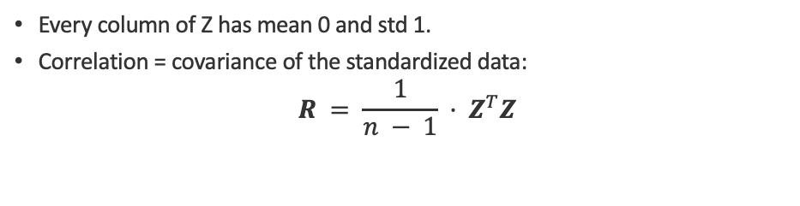
Standardization (Z-scores)
Rescale every feature to mean 0 and standard deviation 1.
Per element
Same data, shifted and rescaled
$$z_{ij} = \frac{x_{ij} − μ_{j}}{σ_{j}}$$
raw values x
μ
subtract the column mean, divide by its std dev
Matrix form
$$z = \frac{x − μ}{σ}$$
$$Z = (X − 1μ^{T})D^{−1} = X_{c}D^{−1}$$
$$D = diag(σ_{1}, σ_{2}, …, σ_{p})$$
-2
-1
0
1
2
Every column of Z has mean 0 and std 1.
Correlation = covariance of the standardized data:
$$R = \frac{1}{n − 1} · Z^{T}Z$$
z (standard units: mean 0, std 1)
Standardizing removes units and scale, so features compare fairly — and R = 1/(n−1)·ZᵀZ.

Slide 181
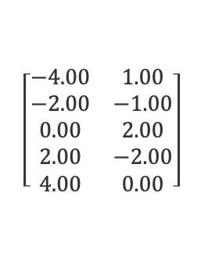
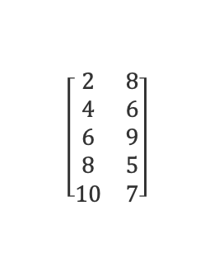
Worked Example 1 — Covariance & Correlation (5×2)
Mean → center → S = XcᵀXc /(n−1) → rescale to R.
Data X (n=5, p=2) (cols: x₁, x₂)
Centered Xc = X − 1μᵀ
Covariance S = XcᵀXc /(n−1)
$$\left[\begin{matrix}2 & 8 \\ 4 & 6 \\ 6 & 9 \\ 8 & 5 \\ 10 & 7\end{matrix}\right]$$
$$\left[\begin{matrix}−4.00 & 1.00 \\ −2.00 & −1.00 \\ 0.00 & 2.00 \\ 2.00 & −2.00 \\ 4.00 & 0.00\end{matrix}\right]$$
10.00
−1.50
−1.50
2.50
μ = ( 6.00, 7.00 )
Each column now sums to 0.
Correlation R = D⁻¹ S D⁻¹
1.00
−0.30
−0.30
1.00
σ = ( 3.16, 1.58 ) · diag(S) = variances
The diagonal of S holds the variances; R rescales every entry to [−1, 1] with 1's on the diagonal.

Slide 182
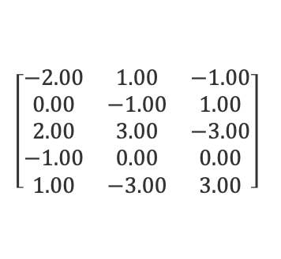
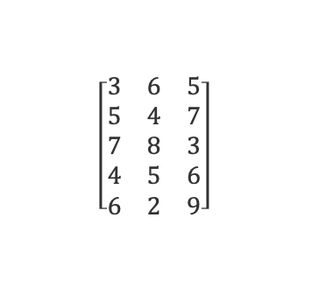
Worked Example 2 — Covariance & Correlation (5×3)
Mean → center → S = XcᵀXc /(n−1) → rescale to R.
Data X (n=5, p=3) (cols: x₁, x₂, x₃)
Centered Xc = X − 1μᵀ
Covariance S = XcᵀXc /(n−1)
$$\left[\begin{matrix}3 & 6 & 5 \\ 5 & 4 & 7 \\ 7 & 8 & 3 \\ 4 & 5 & 6 \\ 6 & 2 & 9\end{matrix}\right]$$
$$\left[\begin{matrix}−2.00 & 1.00 & −1.00 \\ 0.00 & −1.00 & 1.00 \\ 2.00 & 3.00 & −3.00 \\ −1.00 & 0.00 & 0.00 \\ 1.00 & −3.00 & 3.00\end{matrix}\right]$$
2.50
0.25
−0.25
0.25
5.00
−5.00
−0.25
−5.00
5.00
μ = ( 5.00, 5.00, 6.00 )
Each column now sums to 0.
Correlation R = D⁻¹ S D⁻¹
1.00
0.07
−0.07
0.07
1.00
−1.00
−0.07
−1.00
1.00
σ = ( 1.58, 2.24, 2.24 ) · diag(S) = variances
Features 2 and 3 are exact opposites here — their correlation is −1.00.

Slide 183
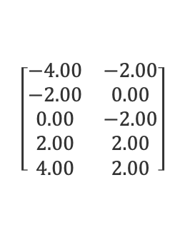
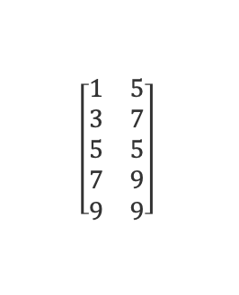
Worked Example 3 — Covariance & Correlation (5×2)
Mean → center → S = XcᵀXc /(n−1) → rescale to R.
Data X (n=5, p=2) (cols: x₁, x₂)
Centered Xc = X − 1μᵀ
Covariance S = XcᵀXc /(n−1)
$$\left[\begin{matrix}1 & 5 \\ 3 & 7 \\ 5 & 5 \\ 7 & 9 \\ 9 & 9\end{matrix}\right]$$
$$\left[\begin{matrix}−4.00 & −2.00 \\ −2.00 & 0.00 \\ 0.00 & −2.00 \\ 2.00 & 2.00 \\ 4.00 & 2.00\end{matrix}\right]$$
10.00
5.00
5.00
4.00
μ = ( 5.00, 7.00 )
Each column now sums to 0.
Correlation R = D⁻¹ S D⁻¹
1.00
0.79
0.79
1.00
σ = ( 3.16, 2.00 ) · diag(S) = variances
Both features rise together here — a strong positive correlation, R₁₂ = 0.79.

Slide 184
Reading S and R as Heatmaps
Color encodes the sign and strength of every entry (5×3 dataset).
Covariance S
Correlation R
x₁
x₂
x₃
x₁
x₂
x₃
2.50
0.25
−0.25
1.00
0.07
−0.07
x₁
x₁
0.25
5.00
−5.00
0.07
1.00
−1.00
x₂
x₂
−0.25
−5.00
5.00
−0.07
−1.00
1.00
x₃
x₃
Cell brightness ∝ |value|; diagonal = variances.
−1
0
+1
Heatmaps reveal structure at a glance: a bright unit diagonal in R, warm cells for positive, cool for negative.

Slide 185
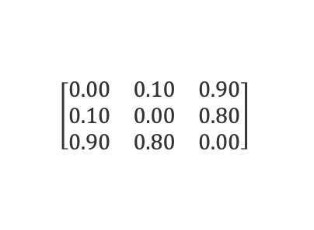
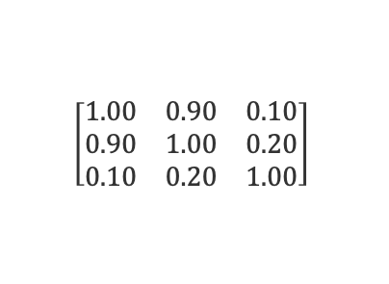
Correlation as a Distance
Convert similarity into distance with d = 1 − r (so r = 1 → d = 0).
Correlation R
Features placed by distance
$$\left[\begin{matrix}1.00 & 0.90 & 0.10 \\ 0.90 & 1.00 & 0.20 \\ 0.10 & 0.20 & 1.00\end{matrix}\right]$$
dᵢⱼ = 1 − rᵢⱼ
d = 0.10
B
r = 1 → d = 0
A
d = 0.90
r = 0 → d = 1
r = −1 → d = 2
similar features
Distance D = 1 − R
d = 0.80
C
$$\left[\begin{matrix}0.00 & 0.10 & 0.90 \\ 0.10 & 0.00 & 0.80 \\ 0.90 & 0.80 & 0.00\end{matrix}\right]$$
A and B are strongly correlated (r=0.9) → close; C is nearly uncorrelated → far.
1 − R is a distance between features: strongly correlated features sit close, weakly correlated ones far apart.

Slide 186
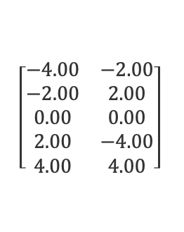
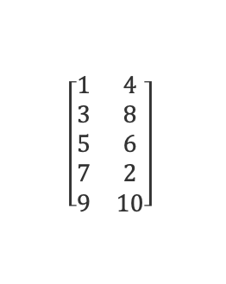
Covariance Matrix — Example 1 (5×2)
Center the data, then S = XcᵀXc /(n−1).
Data X (n=5, p=2) (cols: x₁, x₂)
Xc = X − 1μᵀ → S = XcᵀXc /(n−1)
$$\left[\begin{matrix}1 & 4 \\ 3 & 8 \\ 5 & 6 \\ 7 & 2 \\ 9 & 10\end{matrix}\right]$$
Xc
S
$$\left[\begin{matrix}−4.00 & −2.00 \\ −2.00 & 2.00 \\ 0.00 & 0.00 \\ 2.00 & −4.00 \\ 4.00 & 4.00\end{matrix}\right]$$
10.00
3.00
3.00
10.00
σ = ( 3.16, 3.16 )
μ = ( 5.00, 6.00 )
Covariance = cross-product of the centered data, divided by n−1.

Slide 187
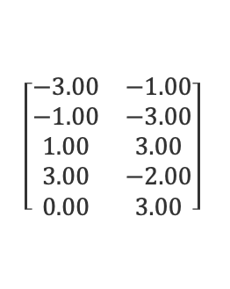
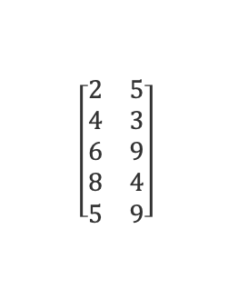
Covariance Matrix — Example 2 (5×2)
Center the data, then S = XcᵀXc /(n−1).
Data X (n=5, p=2) (cols: x₁, x₂)
Xc = X − 1μᵀ → S = XcᵀXc /(n−1)
$$\left[\begin{matrix}2 & 5 \\ 4 & 3 \\ 6 & 9 \\ 8 & 4 \\ 5 & 9\end{matrix}\right]$$
Xc
S
$$\left[\begin{matrix}−3.00 & −1.00 \\ −1.00 & −3.00 \\ 1.00 & 3.00 \\ 3.00 & −2.00 \\ 0.00 & 3.00\end{matrix}\right]$$
5.00
0.75
0.75
8.00
σ = ( 2.24, 2.83 )
μ = ( 5.00, 6.00 )
Covariance = cross-product of the centered data, divided by n−1.

Slide 188
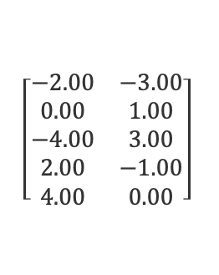
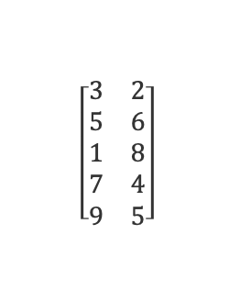
Covariance Matrix — Example 3 (5×2)
Center the data, then S = XcᵀXc /(n−1).
Data X (n=5, p=2) (cols: x₁, x₂)
Xc = X − 1μᵀ → S = XcᵀXc /(n−1)
$$\left[\begin{matrix}3 & 2 \\ 5 & 6 \\ 1 & 8 \\ 7 & 4 \\ 9 & 5\end{matrix}\right]$$
Xc
S
$$\left[\begin{matrix}−2.00 & −3.00 \\ 0.00 & 1.00 \\ −4.00 & 3.00 \\ 2.00 & −1.00 \\ 4.00 & 0.00\end{matrix}\right]$$
10.00
−2.00
−2.00
5.00
σ = ( 3.16, 2.24 )
μ = ( 5.00, 5.00 )
Covariance = cross-product of the centered data, divided by n−1.

Slide 189
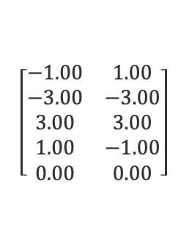
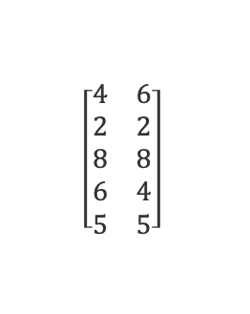
Covariance Matrix — Exercise 1 (5×2)
Center the data, then S = XcᵀXc /(n−1).
Data X (n=5, p=2) (cols: x₁, x₂)
Xc = X − 1μᵀ → S = XcᵀXc /(n−1)
Solution hidden
Work it out, then remove this cover to check.
$$\left[\begin{matrix}4 & 6 \\ 2 & 2 \\ 8 & 8 \\ 6 & 4 \\ 5 & 5\end{matrix}\right]$$
Xc
S
$$\left[\begin{matrix}−1.00 & 1.00 \\ −3.00 & −3.00 \\ 3.00 & 3.00 \\ 1.00 & −1.00 \\ 0.00 & 0.00\end{matrix}\right]$$
5.00
4.00
4.00
5.00
σ = ( 2.24, 2.24 )
μ = ( 5.00, 5.00 )
Task: Compute the covariance matrix S.
Covariance = cross-product of the centered data, divided by n−1.

Slide 190
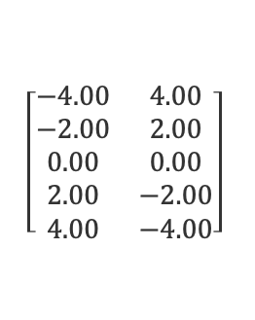
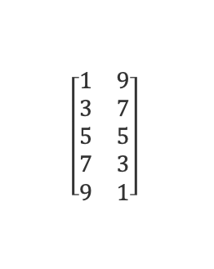
Covariance Matrix — Exercise 2 (5×2)
Center the data, then S = XcᵀXc /(n−1).
Data X (n=5, p=2) (cols: x₁, x₂)
Xc = X − 1μᵀ → S = XcᵀXc /(n−1)
Solution hidden
Work it out, then remove this cover to check.
$$\left[\begin{matrix}1 & 9 \\ 3 & 7 \\ 5 & 5 \\ 7 & 3 \\ 9 & 1\end{matrix}\right]$$
Xc
S
$$\left[\begin{matrix}−4.00 & 4.00 \\ −2.00 & 2.00 \\ 0.00 & 0.00 \\ 2.00 & −2.00 \\ 4.00 & −4.00\end{matrix}\right]$$
10.00
−10.00
−10.00
10.00
σ = ( 3.16, 3.16 )
μ = ( 5.00, 5.00 )
Task: Compute the covariance matrix S.
Covariance = cross-product of the centered data, divided by n−1.

Slide 191
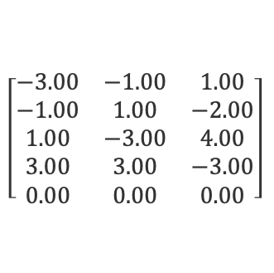
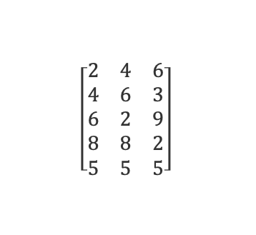
Covariance Matrix — Exercise 3 (5×3)
Center the data, then S = XcᵀXc /(n−1).
Data X (n=5, p=3) (cols: x₁, x₂, x₃)
Xc = X − 1μᵀ → S = XcᵀXc /(n−1)
Solution hidden
Work it out, then remove this cover to check.
$$\left[\begin{matrix}2 & 4 & 6 \\ 4 & 6 & 3 \\ 6 & 2 & 9 \\ 8 & 8 & 2 \\ 5 & 5 & 5\end{matrix}\right]$$
Xc
S
$$\left[\begin{matrix}−3.00 & −1.00 & 1.00 \\ −1.00 & 1.00 & −2.00 \\ 1.00 & −3.00 & 4.00 \\ 3.00 & 3.00 & −3.00 \\ 0.00 & 0.00 & 0.00\end{matrix}\right]$$
5.00
2.00
−1.50
2.00
5.00
−6.00
−1.50
−6.00
7.50
μ = ( 5.00, 5.00, 5.00 )
Task: Compute the covariance matrix S.
Covariance = cross-product of the centered data, divided by n−1.

Slide 192

Correlation Matrix — Example 1 (5×2)
Rescale covariance by the std-devs: R = D⁻¹ S D⁻¹.
Data X (n=5, p=2) (cols: x₁, x₂)
S = XcᵀXc /(n−1) → R = D⁻¹ S D⁻¹
$$\left[\begin{matrix}2 & 3 \\ 4 & 7 \\ 6 & 5 \\ 8 & 9 \\ 5 & 6\end{matrix}\right]$$
S
R
5.00
4.00
1.00
0.80
4.00
5.00
0.80
1.00
μ = ( 5.00, 6.00 )
σ = ( 2.24, 2.24 )
σ = ( 2.24, 2.24 ) · Rᵢⱼ = Sᵢⱼ /(σᵢ σⱼ)
Correlation rescales covariance by the std-devs to land in [−1, 1].

Slide 193

Correlation Matrix — Example 2 (5×2)
Rescale covariance by the std-devs: R = D⁻¹ S D⁻¹.
Data X (n=5, p=2) (cols: x₁, x₂)
S = XcᵀXc /(n−1) → R = D⁻¹ S D⁻¹
$$\left[\begin{matrix}1 & 5 \\ 3 & 3 \\ 5 & 9 \\ 7 & 7 \\ 9 & 1\end{matrix}\right]$$
S
R
10.00
−2.00
1.00
−0.20
−2.00
10.00
−0.20
1.00
μ = ( 5.00, 5.00 )
σ = ( 3.16, 3.16 )
σ = ( 3.16, 3.16 ) · Rᵢⱼ = Sᵢⱼ /(σᵢ σⱼ)
Correlation rescales covariance by the std-devs to land in [−1, 1].

Slide 194

Correlation Matrix — Example 3 (5×3)
Rescale covariance by the std-devs: R = D⁻¹ S D⁻¹.
Data X (n=5, p=3) (cols: x₁, x₂, x₃)
S = XcᵀXc /(n−1) → R = D⁻¹ S D⁻¹
$$\left[\begin{matrix}3 & 6 & 4 \\ 5 & 4 & 6 \\ 7 & 8 & 2 \\ 2 & 5 & 7 \\ 8 & 2 & 6\end{matrix}\right]$$
S
R
6.50
−1.25
−1.75
1.00
−0.22
−0.34
−1.25
5.00
−3.50
−0.22
1.00
−0.78
−1.75
−3.50
4.00
−0.34
−0.78
1.00
μ = ( 5.00, 5.00, 5.00 )
σ = ( 2.55, 2.24, 2.00 )
Rᵢⱼ = Sᵢⱼ /(σᵢ σⱼ); diagonal = 1.
Correlation rescales covariance by the std-devs to land in [−1, 1].

Slide 195

Correlation Matrix — Exercise 1 (5×2)
Rescale covariance by the std-devs: R = D⁻¹ S D⁻¹.
Data X (n=5, p=2) (cols: x₁, x₂)
S = XcᵀXc /(n−1) → R = D⁻¹ S D⁻¹
Solution hidden
Work it out, then remove this cover to check.
$$\left[\begin{matrix}2 & 8 \\ 4 & 6 \\ 6 & 4 \\ 8 & 2 \\ 5 & 5\end{matrix}\right]$$
S
R
5.00
−5.00
1.00
−1.00
−5.00
5.00
−1.00
1.00
μ = ( 5.00, 5.00 )
σ = ( 2.24, 2.24 ) · Rᵢⱼ = Sᵢⱼ /(σᵢ σⱼ)
Task: Compute the correlation matrix R.
Correlation rescales covariance by the std-devs to land in [−1, 1].

Slide 196

Correlation Matrix — Exercise 2 (5×2)
Rescale covariance by the std-devs: R = D⁻¹ S D⁻¹.
Data X (n=5, p=2) (cols: x₁, x₂)
S = XcᵀXc /(n−1) → R = D⁻¹ S D⁻¹
Solution hidden
Work it out, then remove this cover to check.
$$\left[\begin{matrix}1 & 2 \\ 3 & 6 \\ 5 & 4 \\ 7 & 8 \\ 9 & 5\end{matrix}\right]$$
S
R
10.00
4.00
1.00
0.57
4.00
5.00
0.57
1.00
μ = ( 5.00, 5.00 )
σ = ( 3.16, 2.24 )
σ = ( 3.16, 2.24 ) · Rᵢⱼ = Sᵢⱼ /(σᵢ σⱼ)
Task: Compute the correlation matrix R.
Correlation rescales covariance by the std-devs to land in [−1, 1].

Slide 197

Correlation Matrix — Exercise 3 (5×2)
Rescale covariance by the std-devs: R = D⁻¹ S D⁻¹.
Data X (n=5, p=2) (cols: x₁, x₂)
S = XcᵀXc /(n−1) → R = D⁻¹ S D⁻¹
Solution hidden
Work it out, then remove this cover to check.
$$\left[\begin{matrix}4 & 7 \\ 6 & 3 \\ 2 & 9 \\ 8 & 5 \\ 5 & 6\end{matrix}\right]$$
S
R
5.00
−4.00
1.00
−0.80
−4.00
5.00
−0.80
1.00
μ = ( 5.00, 6.00 )
σ = ( 2.24, 2.24 )
σ = ( 2.24, 2.24 ) · Rᵢⱼ = Sᵢⱼ /(σᵢ σⱼ)
Task: Compute the correlation matrix R.
Correlation rescales covariance by the std-devs to land in [−1, 1].

Slide 198


Standardization — Example 1 (5×2)
Z = (X − 1μᵀ) D⁻¹ — every column to mean 0, std 1.
Data X (n=5, p=2) (cols: x₁, x₂)
Z = Xc D⁻¹ (z = (x − μ)/σ) (cols: z₁, z₂)
$$\left[\begin{matrix}2 & 6 \\ 4 & 2 \\ 6 & 8 \\ 8 & 4 \\ 5 & 5\end{matrix}\right]$$
$$\left[\begin{matrix}−1.34 & 0.45 \\ −0.45 & −1.34 \\ 0.45 & 1.34 \\ 1.34 & −0.45 \\ 0.00 & 0.00\end{matrix}\right]$$
μ = ( 5.00, 5.00 )
σ = ( 2.24, 2.24 )
Each column of Z now has mean 0 and standard deviation 1.
Standardizing makes every feature mean 0 and std 1, removing units so features compare fairly.

Slide 199


Standardization — Example 2 (5×2)
Z = (X − 1μᵀ) D⁻¹ — every column to mean 0, std 1.
Data X (n=5, p=2) (cols: x₁, x₂)
Z = Xc D⁻¹ (z = (x − μ)/σ) (cols: z₁, z₂)
$$\left[\begin{matrix}1 & 4 \\ 3 & 8 \\ 5 & 2 \\ 7 & 6 \\ 9 & 5\end{matrix}\right]$$
$$\left[\begin{matrix}−1.26 & −0.45 \\ −0.63 & 1.34 \\ 0.00 & −1.34 \\ 0.63 & 0.45 \\ 1.26 & 0.00\end{matrix}\right]$$
μ = ( 5.00, 5.00 )
σ = ( 3.16, 2.24 )
Each column of Z now has mean 0 and standard deviation 1.
Standardizing makes every feature mean 0 and std 1, removing units so features compare fairly.

Slide 200


Standardization — Example 3 (5×2)
Z = (X − 1μᵀ) D⁻¹ — every column to mean 0, std 1.
Data X (n=5, p=2) (cols: x₁, x₂)
Z = Xc D⁻¹ (z = (x − μ)/σ) (cols: z₁, z₂)
$$\left[\begin{matrix}3 & 9 \\ 5 & 5 \\ 7 & 1 \\ 2 & 7 \\ 8 & 3\end{matrix}\right]$$
$$\left[\begin{matrix}−0.78 & 1.26 \\ 0.00 & 0.00 \\ 0.78 & −1.26 \\ −1.18 & 0.63 \\ 1.18 & −0.63\end{matrix}\right]$$
μ = ( 5.00, 5.00 )
σ = ( 2.55, 3.16 )
Each column of Z now has mean 0 and standard deviation 1.
Standardizing makes every feature mean 0 and std 1, removing units so features compare fairly.

Slide 201


Standardization — Exercise 1 (5×2)
Z = (X − 1μᵀ) D⁻¹ — every column to mean 0, std 1.
Data X (n=5, p=2) (cols: x₁, x₂)
Z = Xc D⁻¹ (z = (x − μ)/σ) (cols: z₁, z₂)
Solution hidden
Work it out, then remove this cover to check.
$$\left[\begin{matrix}2 & 3 \\ 4 & 9 \\ 6 & 5 \\ 8 & 7 \\ 5 & 1\end{matrix}\right]$$
$$\left[\begin{matrix}−1.34 & −0.63 \\ −0.45 & 1.26 \\ 0.45 & 0.00 \\ 1.34 & 0.63 \\ 0.00 & −1.26\end{matrix}\right]$$
μ = ( 5.00, 5.00 )
σ = ( 2.24, 3.16 )
Each column of Z now has mean 0 and standard deviation 1.
Task: Compute the standardized matrix Z.
Standardizing makes every feature mean 0 and std 1, removing units so features compare fairly.

Slide 202


Standardization — Exercise 2 (5×2)
Z = (X − 1μᵀ) D⁻¹ — every column to mean 0, std 1.
Data X (n=5, p=2) (cols: x₁, x₂)
Z = Xc D⁻¹ (z = (x − μ)/σ) (cols: z₁, z₂)
Solution hidden
Work it out, then remove this cover to check.
$$\left[\begin{matrix}6 & 4 \\ 2 & 8 \\ 8 & 2 \\ 4 & 6 \\ 5 & 5\end{matrix}\right]$$
$$\left[\begin{matrix}0.45 & −0.45 \\ −1.34 & 1.34 \\ 1.34 & −1.34 \\ −0.45 & 0.45 \\ 0.00 & 0.00\end{matrix}\right]$$
μ = ( 5.00, 5.00 )
σ = ( 2.24, 2.24 )
Each column of Z now has mean 0 and standard deviation 1.
Task: Compute the standardized matrix Z.
Standardizing makes every feature mean 0 and std 1, removing units so features compare fairly.

Slide 203


Standardization — Exercise 3 (5×2)
Z = (X − 1μᵀ) D⁻¹ — every column to mean 0, std 1.
Data X (n=5, p=2) (cols: x₁, x₂)
Z = Xc D⁻¹ (z = (x − μ)/σ) (cols: z₁, z₂)
Solution hidden
Work it out, then remove this cover to check.
$$\left[\begin{matrix}1 & 7 \\ 9 & 3 \\ 5 & 5 \\ 3 & 9 \\ 7 & 1\end{matrix}\right]$$
$$\left[\begin{matrix}−1.26 & 0.63 \\ 1.26 & −0.63 \\ 0.00 & 0.00 \\ −0.63 & 1.26 \\ 0.63 & −1.26\end{matrix}\right]$$
μ = ( 5.00, 5.00 )
σ = ( 3.16, 3.16 )
Each column of Z now has mean 0 and standard deviation 1.
Task: Compute the standardized matrix Z.
Standardizing makes every feature mean 0 and std 1, removing units so features compare fairly.

Slide 204
?
DISTANCE-BASED LEARNING
KNN Algorithm
k-Nearest Neighbors — classify and predict from the closest points in feature space.

Slide 205
What KNN Is Used For
A simple, distance-based method for classification and regression.
Classify a new point by its k nearest neighbors
How it works
Find the k points closest to the new point (by distance).
Vote: take the majority label — or average them for regression.
Used for
Classification and regression.
Recommendation, missing-value imputation, anomaly detection.
?
Key choices
k — how many neighbors to poll.
Distance metric (Euclidean — see Distance).
Feature scaling (standardize first — see Standardization).
Class A
Class B
? new point (k = 3)
KNN predicts from the k closest points — so the distance metric and feature scaling we just covered drive everything.

Slide 206


K-Nearest Neighbors — Vector & Matrix Formulation
KNN expressed with the data matrix $X$, query vector $q$, and the row-wise Euclidean norm
Setup
$X ∈ ℝ^{n×d}$ data matrix ($n$ points, $d$ features)
$y ∈ {\left\{A,B\right\}}^{n}$ label vector
$q ∈ ℝ^{d}$ query vector
1. Distance vector (row norms)
$d_{i} = {\left\|x_{i} − q\right\|}_{2}$ for $i = 1..n$
2. Sort ascending
$π = argsort\left(d\right)$
3. Take K nearest indices
$N = π\left[1:K\right]$
4. Majority vote over labels
$ŷ = mode\left(y\left[N\right]\right)$
5. Return $ŷ = {argmax}_{c} \sum_{n∈N}{1\left\{y_{n} = c\right\}}$
Key Concepts
▸ Norm choice
${\left\|·\right\|}_{2}$ Euclidean, ${\left\|·\right\|}_{1}$ Manhattan, or ${\left\|·\right\|}_{p}$ Minkowski on the rows of $X − 1q^{T}$
▸ Vectorized distance
All $n$ distances are one broadcast subtraction plus a row-wise norm — no Python loop needed
▸ argsort, not full sort
Only the $K$ smallest entries of $d$ are required; a partial argsort is $O\left(n\right)$
▸ Majority vote
$ŷ$ = mode of $y$ over the $K$ nearest rows; odd $K$ avoids ties
▸ Lazy learner
No training: $X$ and $y$ are stored; all work is the $q$-time norm evaluation

Slide 207











Curse of dimensionality — Stage 1: $d = 1$ (matrix / vector form)
Training set as matrix $X ∈ ℝ^{5×1}$ (label vector $y$)
Query $q$
Metric $\left\|x_{i} − q\right\|$
$X^{T} = \left[1 2 4 7 9\right]$ $y = \left[A A B B B\right]$
$$q = \left[5\right]$$
$$d_{i} = \left|x_{i} − q\right| = {\left\|x_{i} − q\right\|}_{1}$$
Step 1 — distance vector $d = \left\|X − 1q^{T}\right\|$ (row-wise)
Step 2 — 3-NN majority vote
$$d_{1} = \left\|x_{1} − q\right\| = \left|1 − 5\right|$$
$$4$$
Sort $d$: $π = argsort\left(d\right) = \left[3, 4, 2, 1, 5\right]$
$$d_{2} = \left\|x_{2} − q\right\| = \left|2 − 5\right|$$
$$3$$
NN
$$N = π\left[1:3\right] = \left\{x_{3}, x_{4}, x_{2}\right\}$$
$$y\left[N\right] = \left[B B A\right]$$
$$d_{3} = \left\|x_{3} − q\right\| = \left|4 − 5\right|$$
$$1$$
NN
$$ŷ = mode\left(y\left[N\right]\right) = B$$
(2 of 3)
$$d_{4} = \left\|x_{4} − q\right\| = \left|7 − 5\right|$$
$$2$$
NN
$$d_{5} = \left\|x_{5} − q\right\| = \left|9 − 5\right|$$
$$4$$
Distance diagnostic — spread of the norm vector $d$
$max\left(d\right) = 4$ $min\left(d\right) = 1$
$ratio = max\left(d\right) / min\left(d\right) = 4.00×$ — the nearest point is 4× closer than the farthest
In $d = 1$ the norm vector $d$ is highly discriminative: a 4× gap between nearest and farthest. KNN's similarity signal is strong.

Slide 208










Curse of dimensionality — Stage 2: $d = 2$ (matrix / vector form)
Metric ${\left\|x_{i} − q\right\|}_{2}$
Training matrix $X ∈ ℝ^{5×2}$ (rows = points)
Query $q$
$$d_{i} = \sqrt{\sum_{j}{{\left(x_{ij} − q_{j}\right)}^{2}}}$$
$X = \left[\left(1,2\right)\left(2,1\right)\left(4,8\right)\left(7,5\right)\left(9,9\right)\right]$ $y = \left[A A B B B\right]$
$$q = \left(5, 5\right)$$
Step 1 — distance vector $d = {\left\|X − 1q^{T}\right\|}_{2,row}$
Step 2 — 3-NN majority vote
$$π = argsort\left(d\right) = \left[4, 3, 1, 2, 5\right]$$
$$d_{1} = \sqrt{{\left(5−1\right)}^{2}+{\left(5−2\right)}^{2}} = \sqrt{25}$$
$$5.00$$
NN
$$N = \left\{x_{4}, x_{3}, x_{1}\right\}$$
labels $B, B, A$ · $d = 2.00, 3.16, 5.00$
$$d_{2} = \sqrt{{\left(5−2\right)}^{2}+{\left(5−1\right)}^{2}} = \sqrt{25}$$
$$5.00$$
$ŷ = mode\left(y\left[N\right]\right) = B$ (2 of 3)
$$d_{3} = \sqrt{{\left(5−4\right)}^{2}+{\left(5−8\right)}^{2}} = \sqrt{10}$$
$$3.16$$
NN
$$d_{4} = \sqrt{{\left(5−7\right)}^{2}+{\left(5−5\right)}^{2}} = \sqrt{4}$$
$$2.00$$
NN
$$d_{5} = \sqrt{{\left(5−9\right)}^{2}+{\left(5−9\right)}^{2}} = \sqrt{32}$$
$$5.66$$
Distance diagnostic — spread of the norm vector $d$
$max\left(d\right) = 5.66$ $min\left(d\right) = 2.00$
$ratio = max\left(d\right) / min\left(d\right) = 2.83×$ — distances still discriminate, though the gap is shrinking
In $d = 2$ the nearest neighbor is still 2.83× closer than the farthest. The norm vector remains informative.

Slide 209










Curse of dimensionality — Stage 3: $d = 10$ (matrix / vector form)
Training matrix $X ∈ ℝ^{5×10}$ (rows = 10-D points)
Query $q$
Metric ${\left\|x_{i} − q\right\|}_{2}$ over $j = 1..10$
$X$: $x_{1},x_{2} → A$ $x_{3},x_{4},x_{5} → B$ (entries in $\left[0,9\right]$)
$$q = \left(5,…,5\right)$$
$$d_{i} = \sqrt{\sum_{j=1}^{10}{{\left(x_{ij} − q_{j}\right)}^{2}}}$$
Step 1 — distance vector $d = {\left\|X − 1q^{T}\right\|}_{2,row}$
Step 2 — 3-NN majority vote
$$π = argsort\left(d\right) = \left[3, 5, 1, 2, 4\right]$$
$$d_{1} = {\left\|x_{1} − q\right\|}_{2} = \sqrt{68}$$
$$8.25$$
NN
$$N = \left\{x_{3}, x_{5}, x_{1}\right\}$$
labels $B, B, A$ · $d = 8.06, 8.19, 8.25$
$$d_{2} = {\left\|x_{2} − q\right\|}_{2} = \sqrt{70}$$
$$8.37$$
$ŷ = B$ (2 of 3) — margin only $0.12$
$$d_{3} = {\left\|x_{3} − q\right\|}_{2} = \sqrt{65}$$
$$8.06$$
NN
$$d_{4} = {\left\|x_{4} − q\right\|}_{2} = \sqrt{72}$$
$$8.49$$
$$d_{5} = {\left\|x_{5} − q\right\|}_{2} = \sqrt{67}$$
$$8.19$$
NN
Distance diagnostic — spread of the norm vector $d$
$max\left(d\right) = 8.49$ $min\left(d\right) = 8.06$
$ratio = max\left(d\right) / min\left(d\right) = 1.05×$ — all five neighbors lie within about 5% of each other
In d = 10 the norm vector collapses: nearest and farthest differ by only about 5%. The KNN similarity signal is essentially gone — the curse of dimensionality.

